Slide 1
City of Wilmington Green Jobs Program
2023 CDRW Annual Conference
Martha Corrozi Narvaez
Delaware Water Resources Center
Biden School of Public Policy & Administration
University of Delaware

Slide 2
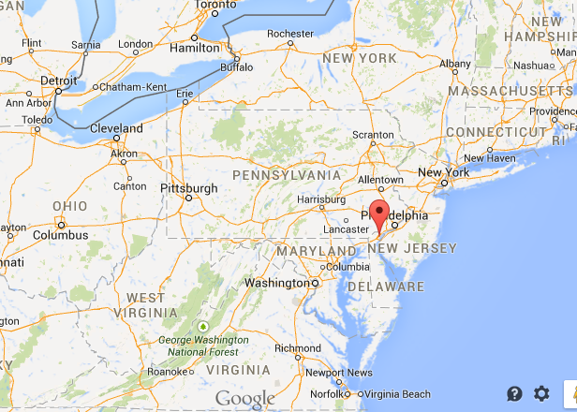
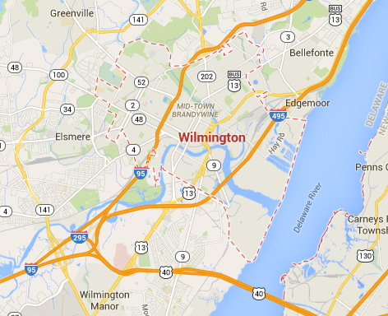
Wilmington, Delaware

Slide 3
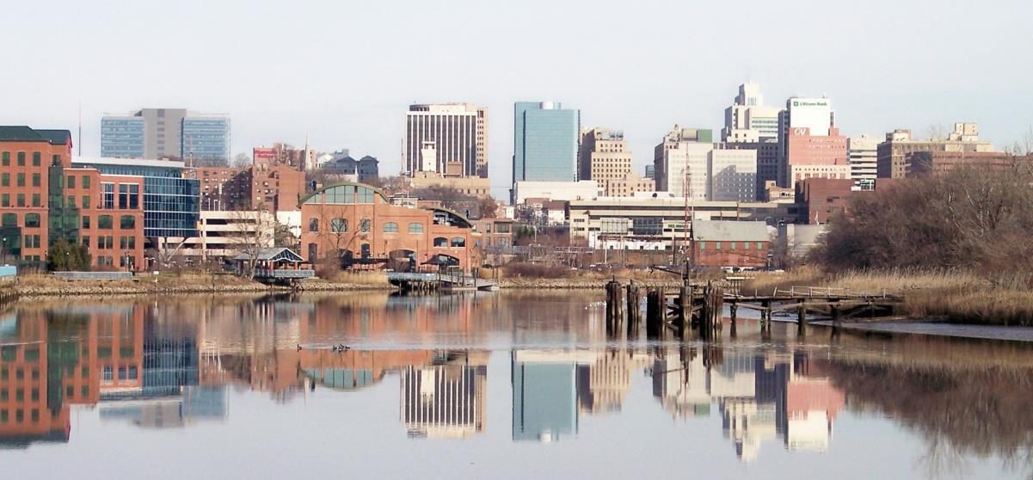
The City of Wilmington
Population: >70,000
Population density: 6,500 people/sq. mi.
Urban/suburban landuse
Source: wikimedia.org

Slide 4
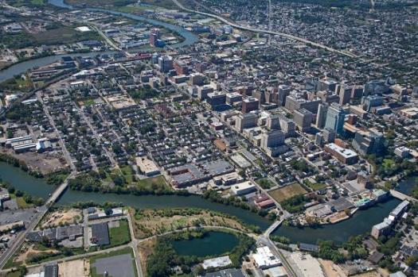
The City of Wilmington (cont.)
Water Resources Background:
Water supply
Wastewater loads
Urban/suburban pollution loads
Historic industrial sites
Federal Regulations:
NPDES (National Pollutant Discharge Elimination System)
CSO (Combined Sewer Overflow)
TMDLs (Total Maximum Daily Loads)
Aerial view of the City of Wilmington

Slide 5
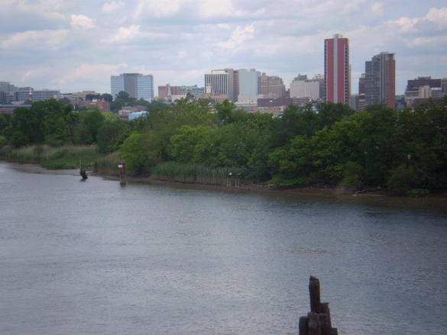
The Spark
Discussions with the City and State – 2010
Permit requirements
Grant opportunities
Program began – June 2011
Source: images.topix.com

Slide 6
The Program
The City of Wilmington’s Green Jobs Program engages the City’s youth by providing summer work opportunities.
The youth participate in hands-on work experience and classroom environmental education that introduces them to environmental issues and careers.
Wilmington’s youth can help to transform the city into a greener, cleaner, safer community while experiencing meaningful employment and education opportunities.

Slide 7
Program Details
14 participants chosen through program selection and interview process.
14-18 years old.
6 weeks, 25 hours/week.
Approx. $1,700 per summer (minimum wage).
1 counselor oversees 14 interns.

Slide 8
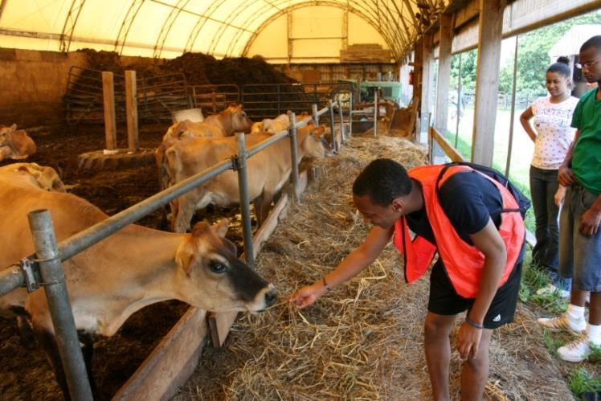
Program Timeline
Applications due to the City - mid/late April
Training and screening - May/June
Program begins - last week in June
Program ends – first week in August

Slide 9
Program Organization

Slide 10
Host Organizations
Academy of Natural Sciences of Drexel University
Brandywine Red Clay Alliance
Center for Inland Bays
City of Wilmington Parks and Recreation
City of Wilmington Public Works
Delaware Department of Natural Resources and Environmental Control
Delaware Department of Technology and Information
Delaware Interfaith Power &Light
Delaware Sea Grant
Delaware Solid Waste Authority
Delaware State University
Delaware State Parks
Eco Plastics Products of Delaware
Food Bank of Delaware
Lincoln University
Mid-Atlantic Youth Anglers and Outdoors Program
New Castle Conservation District
Partnership for the Delaware Estuary
RK&K
Straughan Environmental
Stroud Water Research Center
The Nature Conservancy, (DE/PA Chapters)
The Village Tree, Inc.
University of Delaware Botanic Gardens
University of Delaware Geography Department
University of Delaware Water Resources Center
University of Delaware Cooperative Extension
University of Pennsylvania Water Center

Slide 11
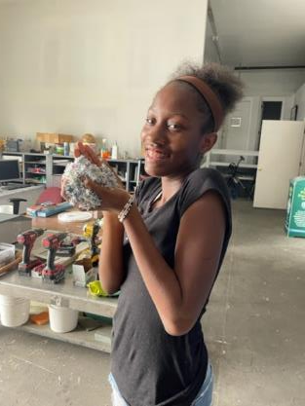
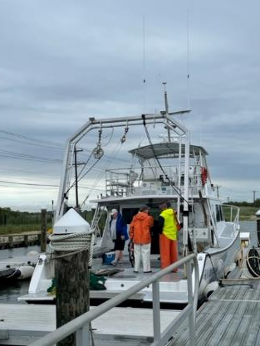
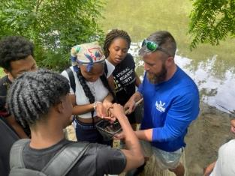
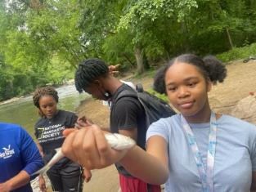
The program includes a variety of activities for 6 weeks!

Slide 12
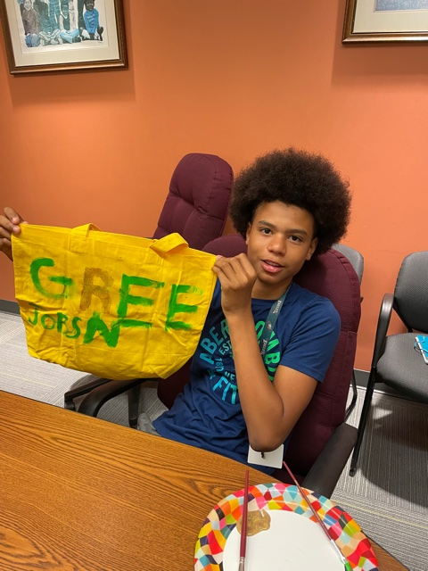
Activities
Planting and maintaining urban gardens in the City (watering, pruning, mulching)
Maintaining parks and trails
Monitoring water quality
Removing invasive plant species
Planting trees
Surveying mussels in local streams
Hiking in local natural areas
Fishing
Canoeing
Learning about environmental research and careers
Professional development and career preparedness

Slide 13
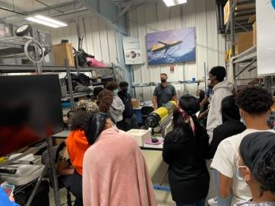
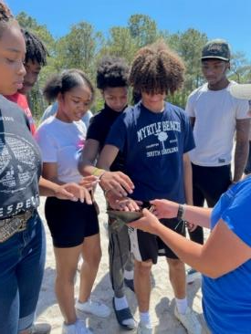
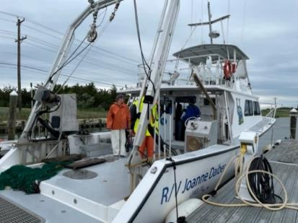
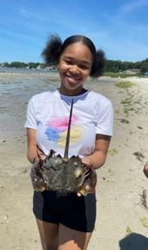
2022 Inaugural Orientation Event
Overnight orientation trip to Ocean View and Lewes, Delaware with the Center for Inland Bays and University of Delaware Sea Grant

Slide 14
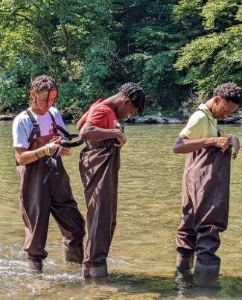
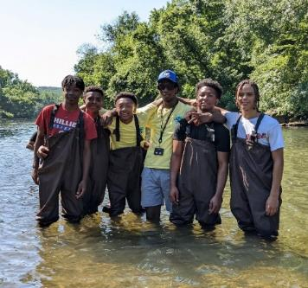
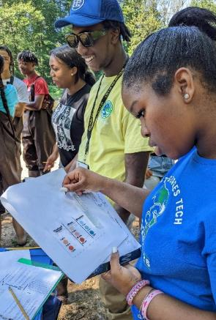
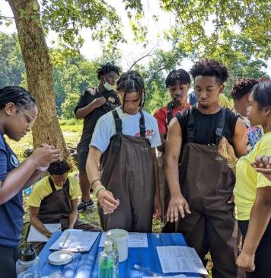
Testing Water Quality and Exploring at First State National Park

Slide 15
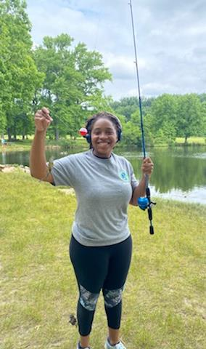
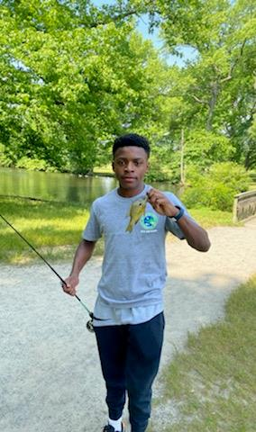
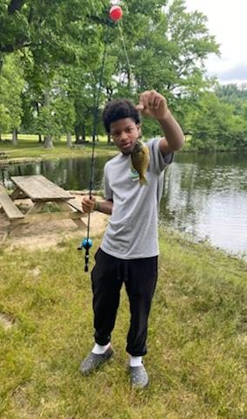
A successful fishing trip with Mid-Atlantic Youth Anglers and Outdoors Program

Slide 16
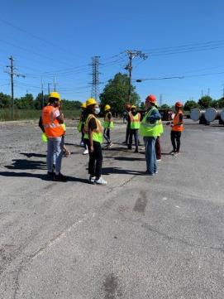
Learning about the City of Wilmington’s drinking water and wastewater Systems and environmental careers

Slide 17
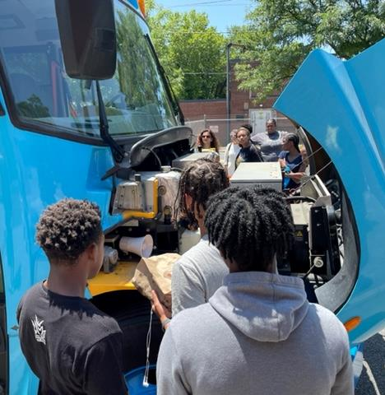
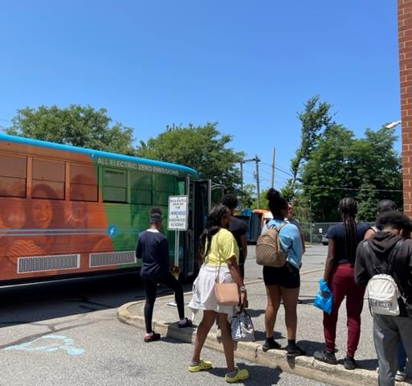
Learning about climate change and taking a ride on an electric school bus

Slide 18
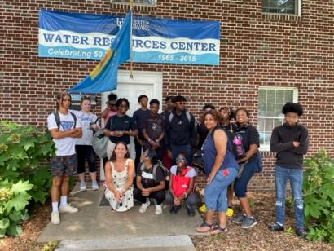
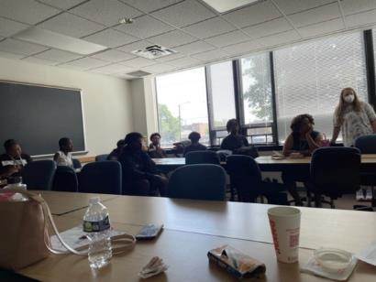
Tours and discussions with the University of Delaware and Delaware State University

Slide 19
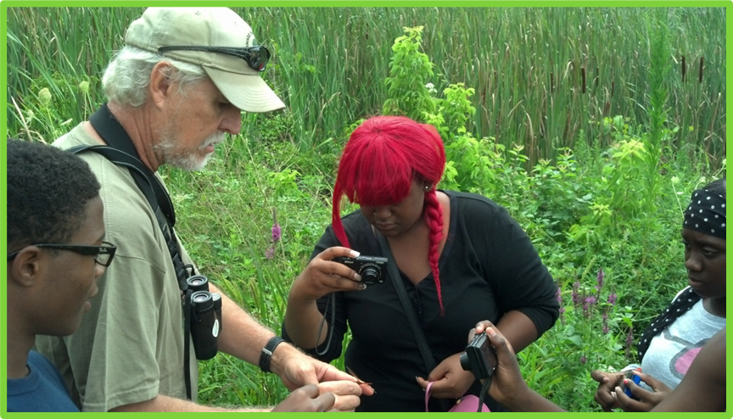
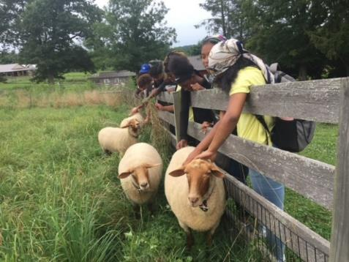
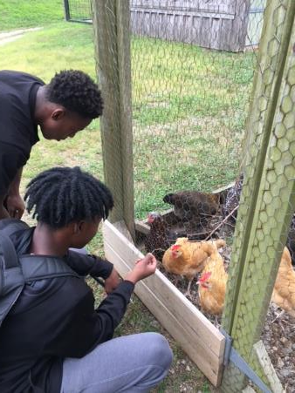
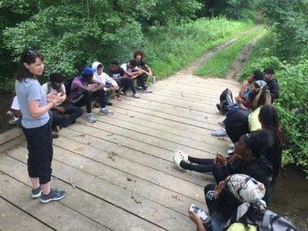
Several days with the Delaware Nature Society at the Ashland Nature Center and the DuPont Environmental Education Center (DEEC)

Slide 20
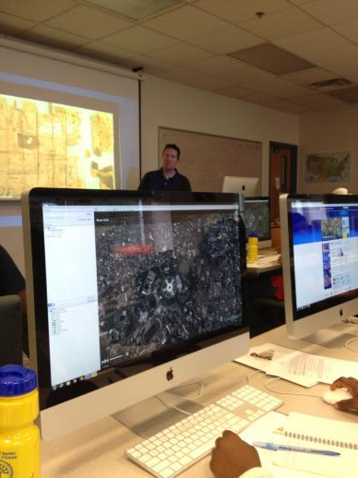
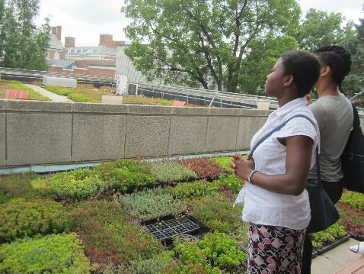
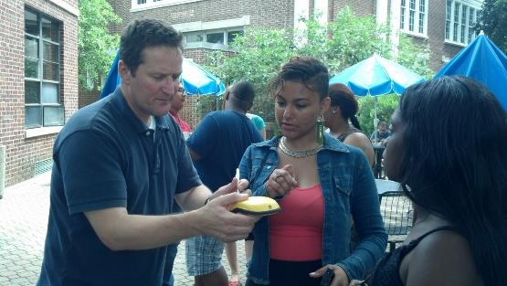
University of Delaware Days: Geospatial Intelligence, UD Ag Farm, and Green Roof

Slide 21
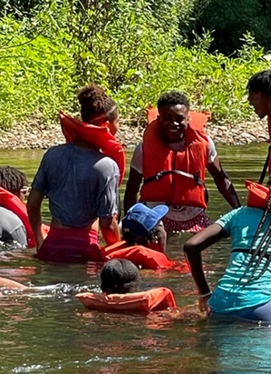
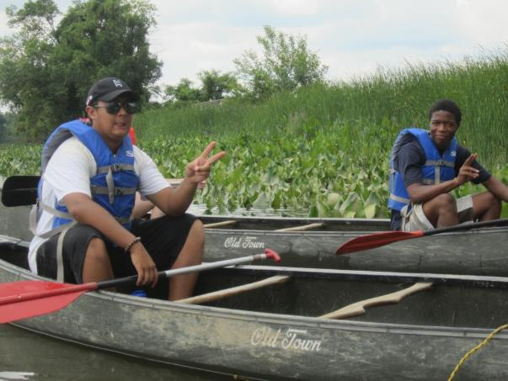
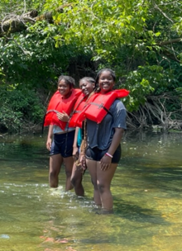
Canoeing on the Brandywine and Christina Rivers

Slide 22
Community Gardening Delaware Center for Horticulture and Urban Environmental Center

Slide 23
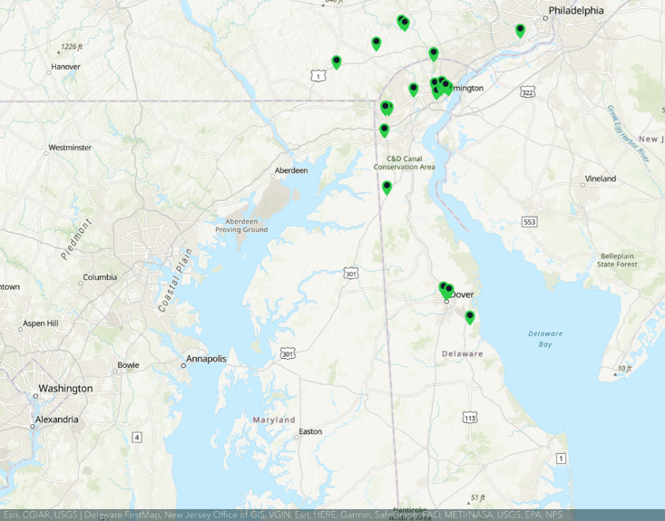
NEW!
ArcGIS Story Maps
Interns created & presented Story Maps at the program’s closing ceremony.

Slide 24
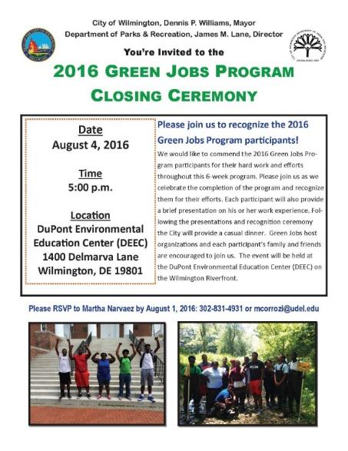
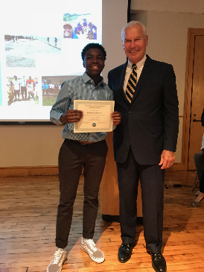
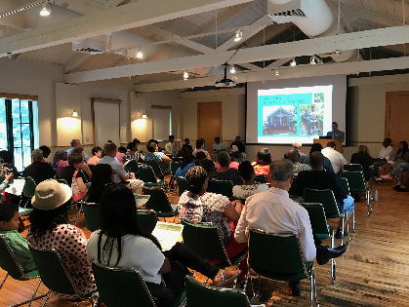
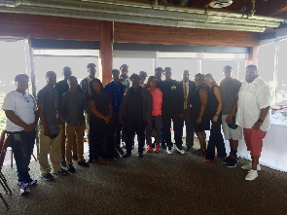
Closing Ceremony

Slide 25
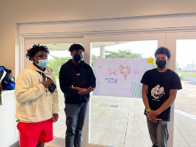
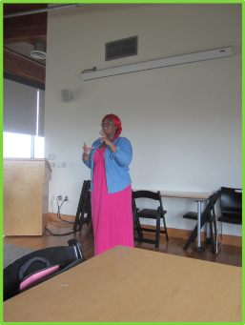
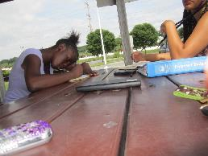
Professional Development
Resume Writing
Public Speaking
Journaling
Budgeting
Networking

Slide 26
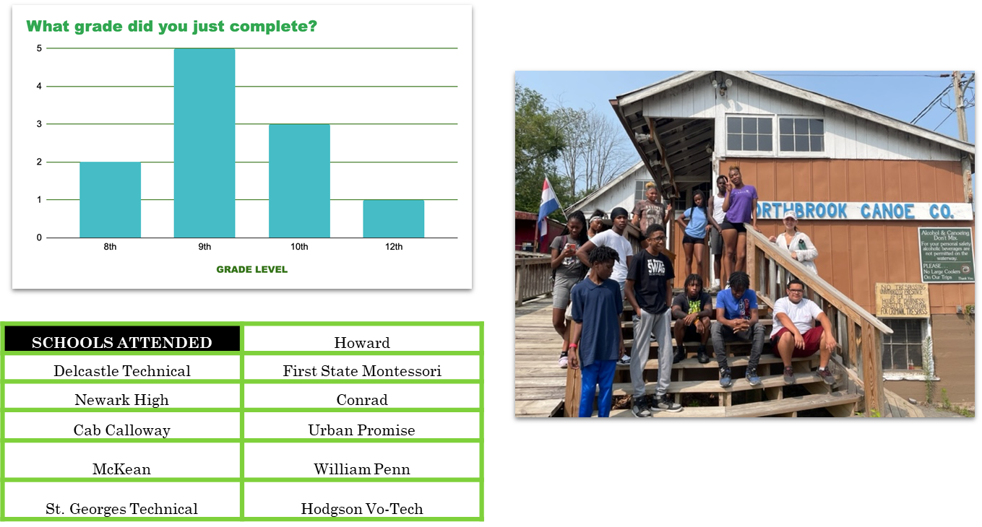
2023 Summer Snapshot
2023 Interns

Slide 27
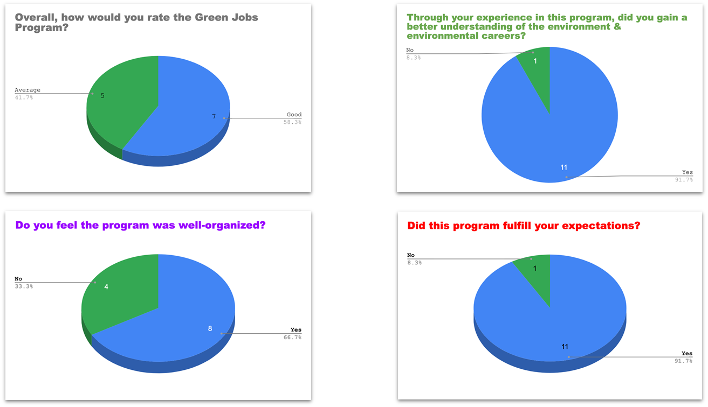
2023 Summer Snapshot

Slide 28
What environmental information will you be sharing with people you know?
“About the wetlands and what we do on land goes into the water”
“I will tell them about watersheds and wetlands”
“That our water in Wilmington is clean and filtered from the brandywine, the trees all have there different names”
“Stop littering”
“Be more engaged in the environment”
“Keep the world safe”
“Trees are good”
“About the wetlands”
“Delaware bares the problems from trash”
“Environmental information on how the more trees you have where you live, the cooler it is, so it can be hotter in different locations”

Slide 29
2023 Summer Snapshot
What are your favorite and least favorite activities?

Slide 30
2023 Summer Snapshot
Green Jobs Interns think of nature as….

Slide 31
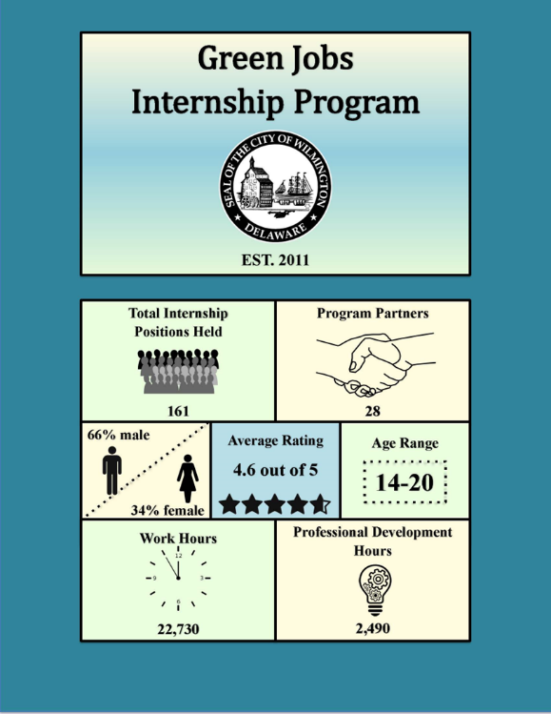
Next Steps for this Program
Yearly Improvement Based on Program Evaluations and Opportunity
Funding
Impact Study
Program Enhancements based on Impact Study Results

Slide 32
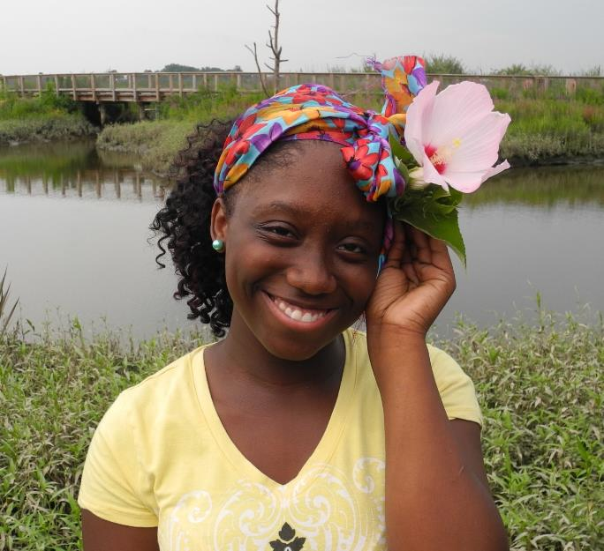
Thank You!
o credit: Delaware Department of Natural Resources and Environmental Control (DNREC)
http://www.youtube.com/watch?v=3URbmY35GmU
Martha Corrozi Narvaez
Delaware Water Resources Center
Biden School of Public Policy & Administration
University of Delaware
mcorrozi@udel.edu

