Slide 1
Agricultural BMPs and Water Quality in the Red and White Clay Creek Watersheds
Brandywine-Christina Cluster
Toward a Watershed-based return on investment
Andrew Homsey & Jerry Kauffman (UD) | Brian Boutin (TNC)
Natural Lands Trust | Cheslen Preserve | March 3, 2016

Slide 2
Topics
Overview of the watershed
Opportunities for agricultural remediation
  We look at agricultural uses primarily
  Inventory and summarize farmland “opportunities”
  Basin wide
Costs and Loads
  MapShed modeling
  Focus on Red and White Clay Creek watersheds
  Look at reductions and costs
InVEST/RIOs
  Allocation, prioritization
Discussion

Slide 3
Partnerships are critical
UD/TNC
Steering Committee
Advisory Panel
CCWRA, CCCD, CTIP, WCC W&S
BRCA (aka BVA/RCVA), Brandywine Conservancy, Cluster partners
Water companies, MS4 communities, municipalities, counties, DNREC/DEP

Slide 4
1 - Overview

Slide 5
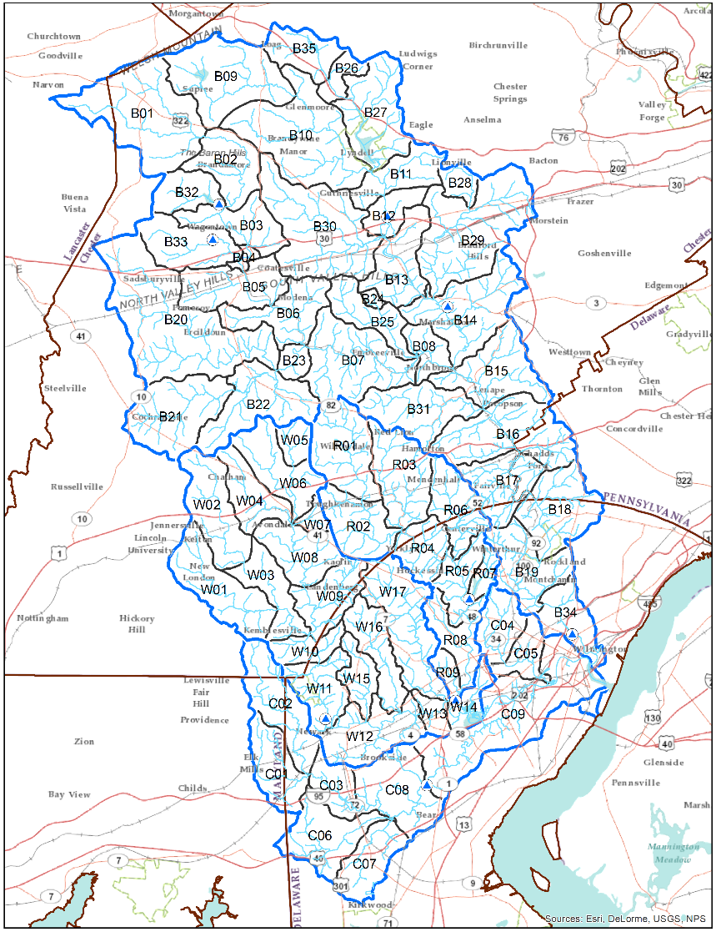

Slide 6
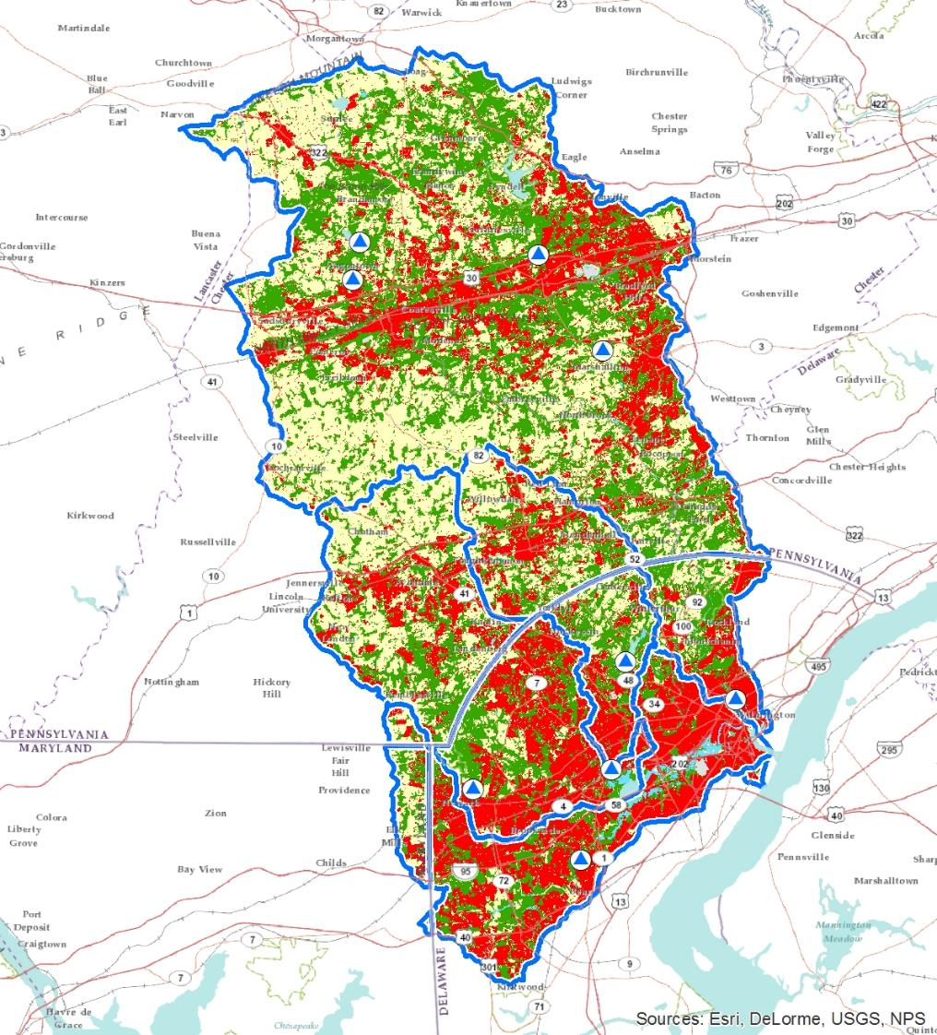

Slide 8
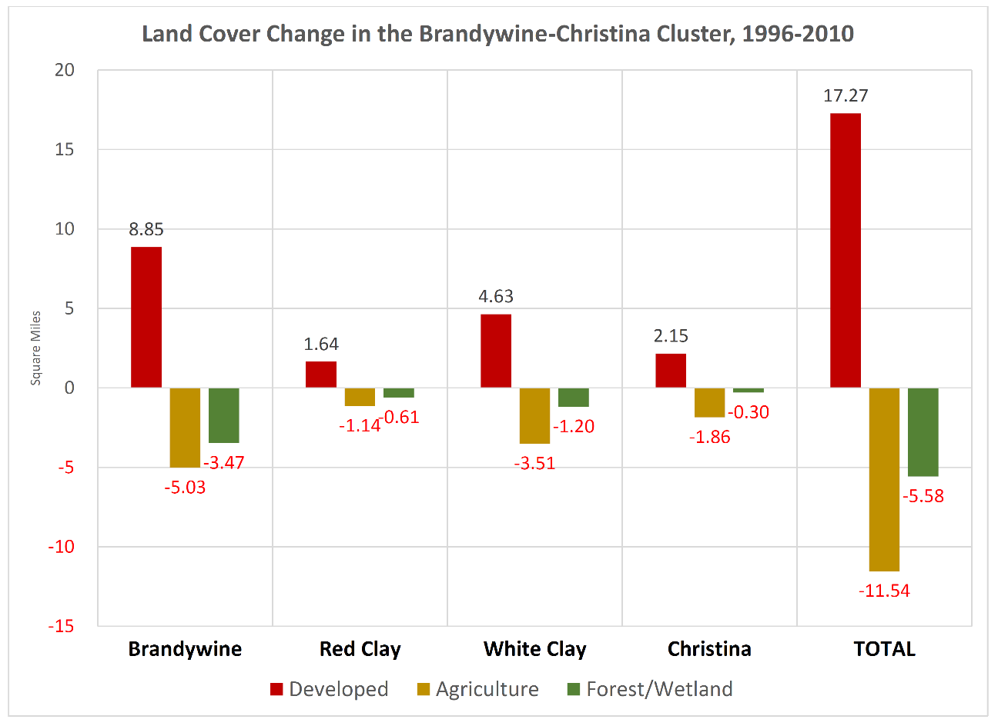

Slide 9
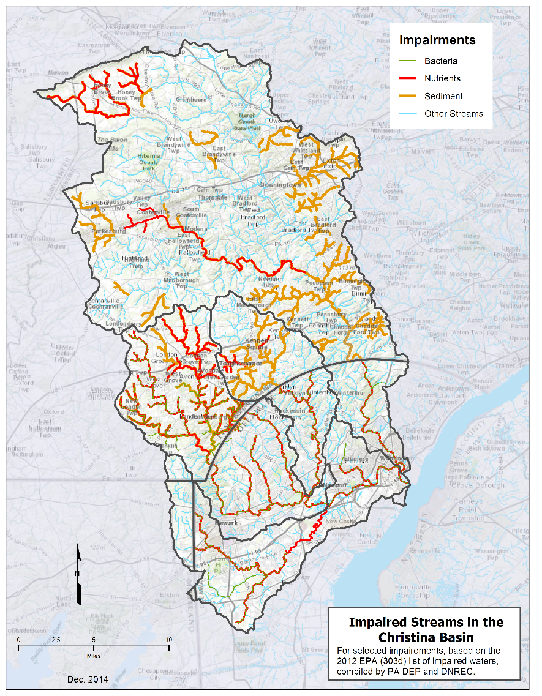

Slide 10
Prioritization depends on interest
CTIP
Cluster partners
TMDLs
Purveyors: Wilmington, United, Newark, Aqua, PA American, others
BVA, DNREC, DEP, CCWRA, CCCD, BC, Stroud, Watershed teams, WCU, Municipalities/MS4s, PDE, DNS, NLT, USACE
Coordination is key.

Slide 11
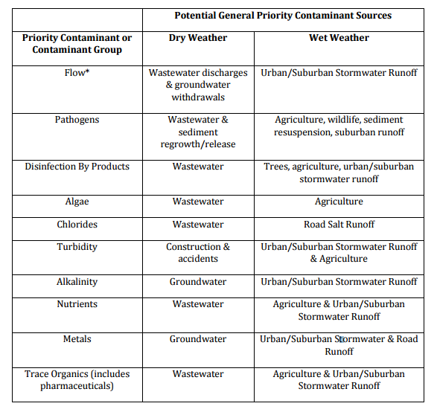
Wilmington Sourcewater Plan, 2010

Slide 12
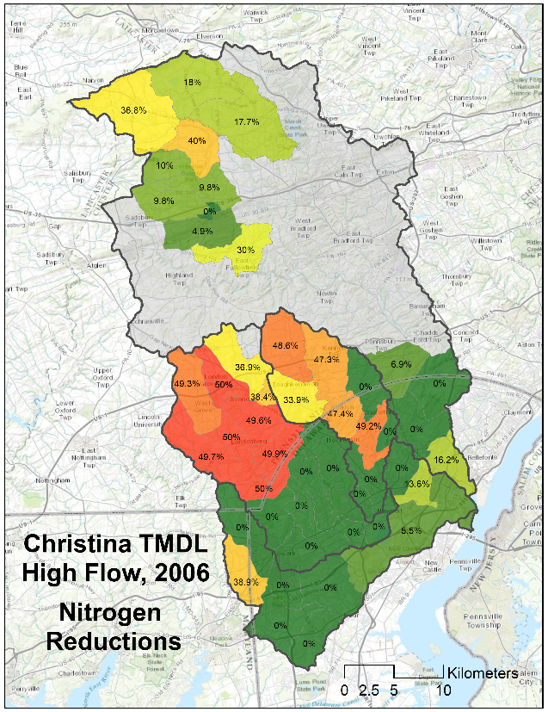
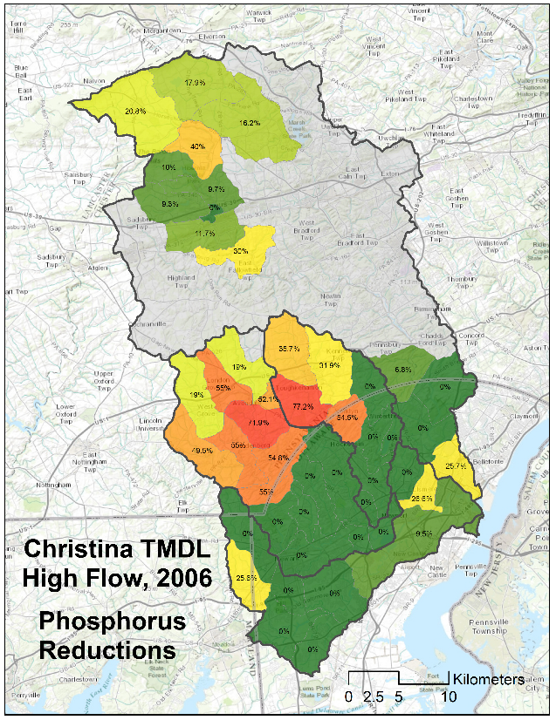
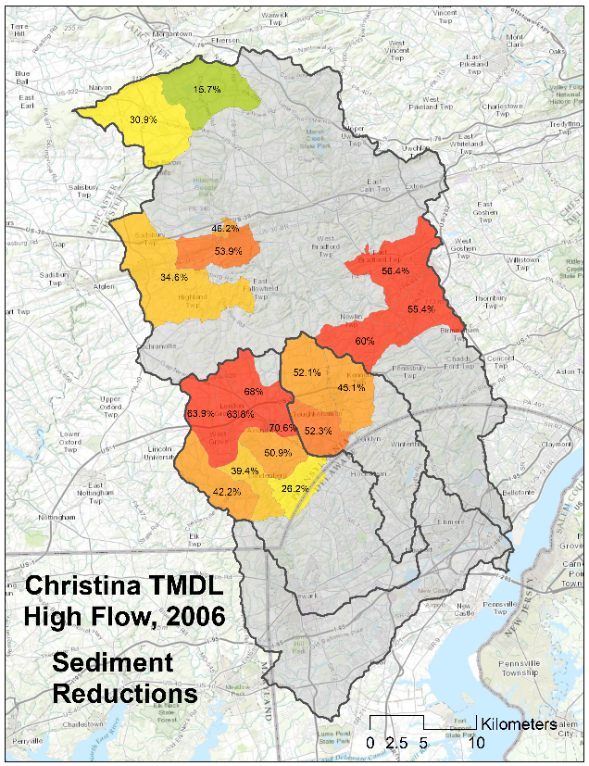
2 - Opportunities
TMDL, based on HSPF (1994-1998)

Slide 13
Farmland overview
In cooperation with the CCCD
GIS analysis and overlay
Give an idea of the magnitude and location of the opportunities

Slide 14
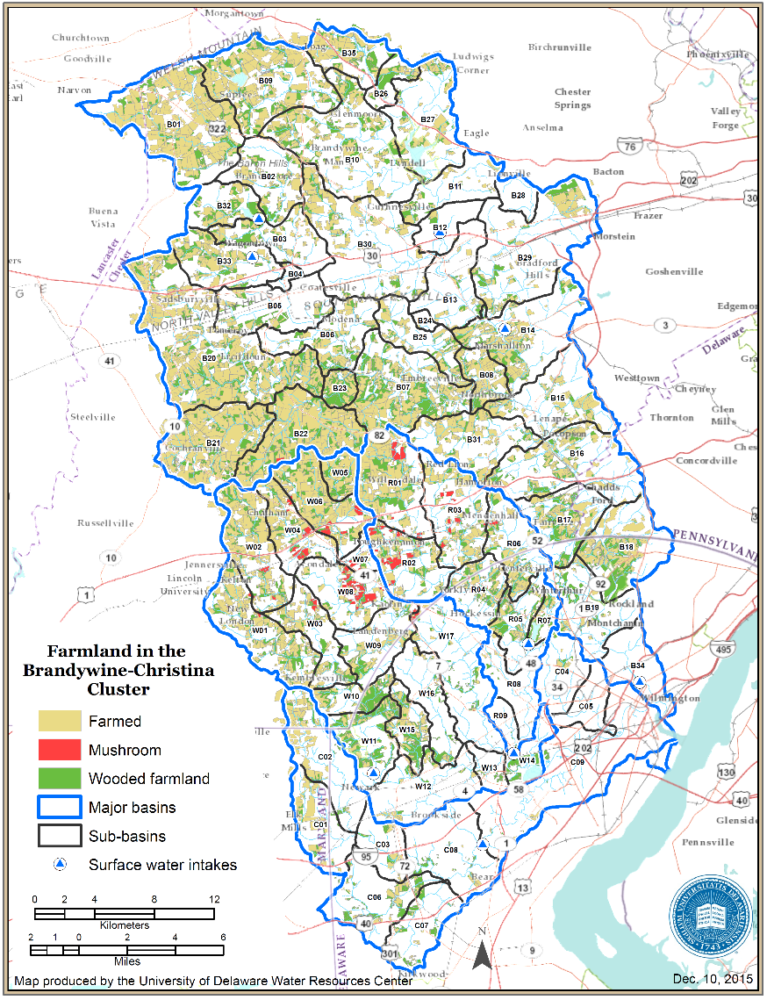

Slide 15
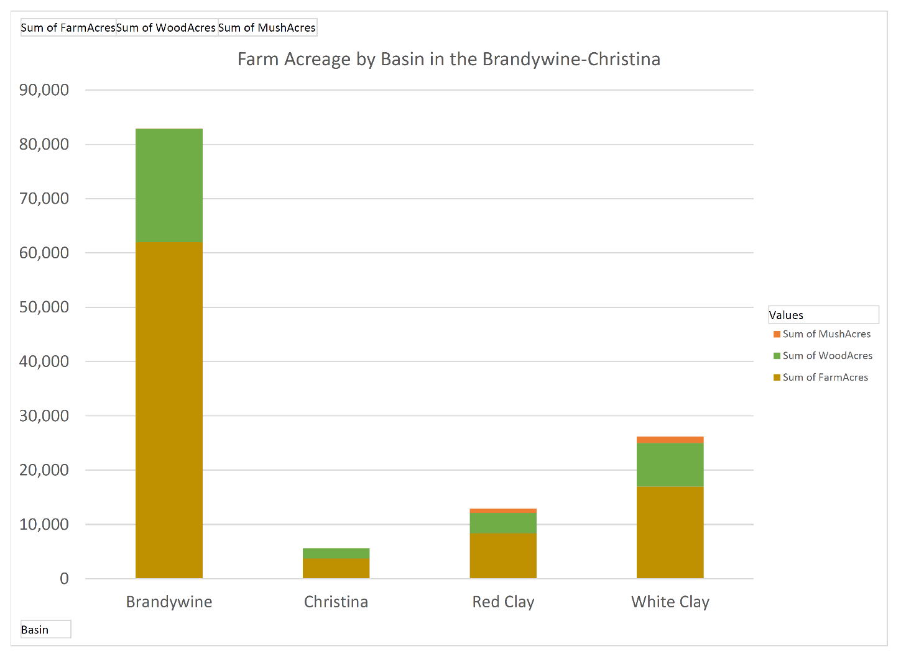
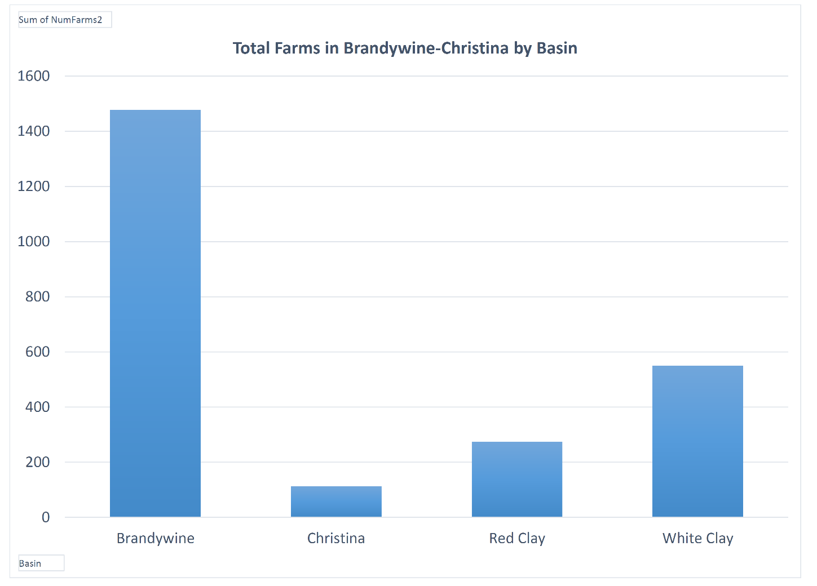

Slide 16
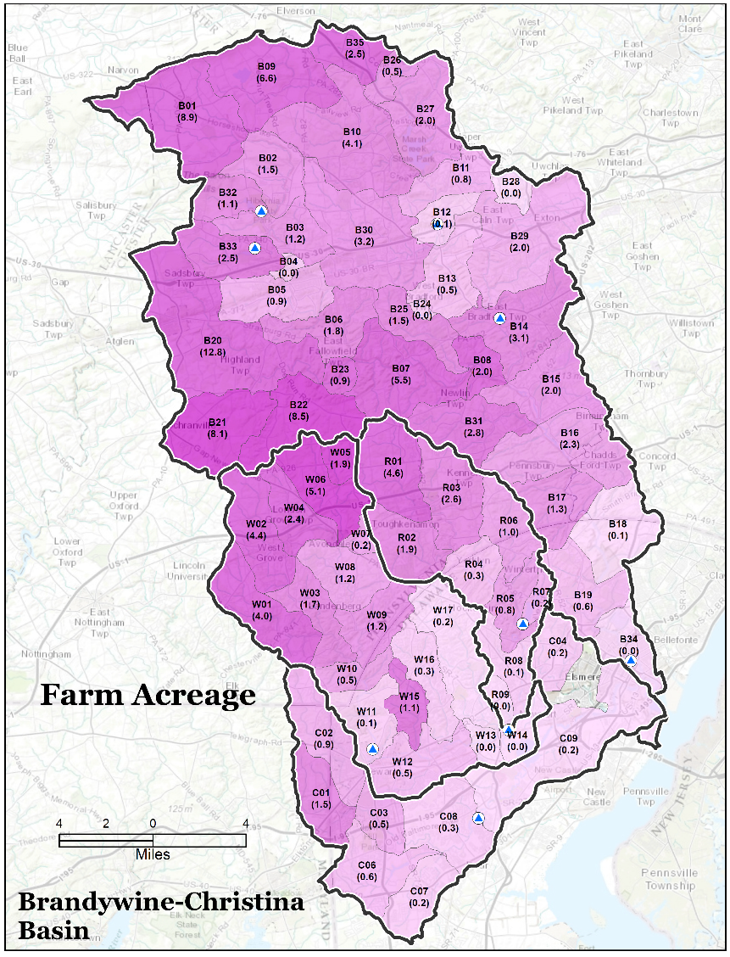
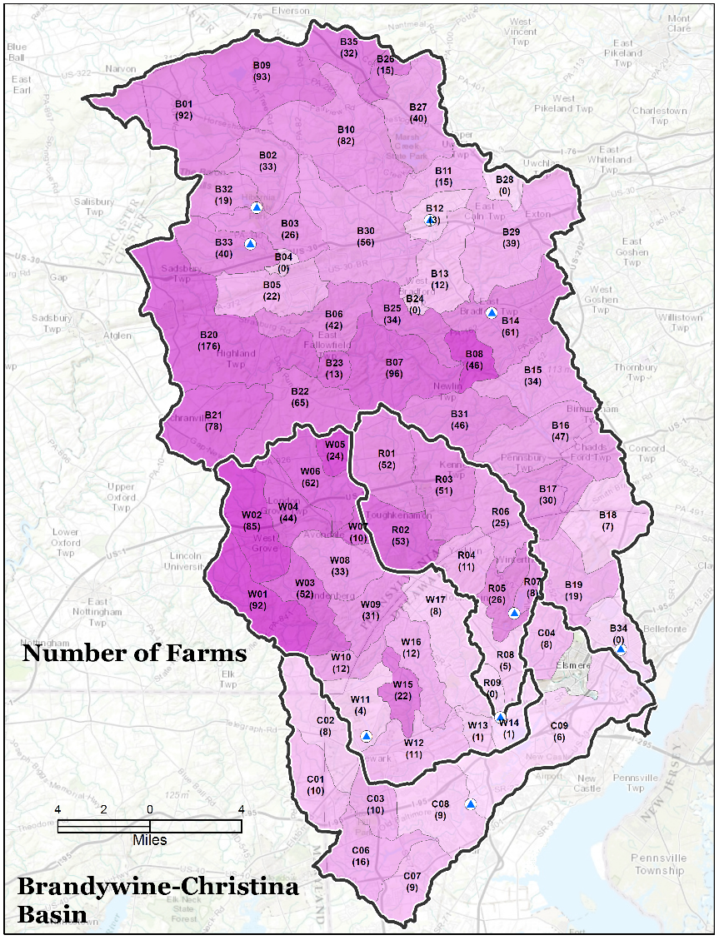

Slide 17
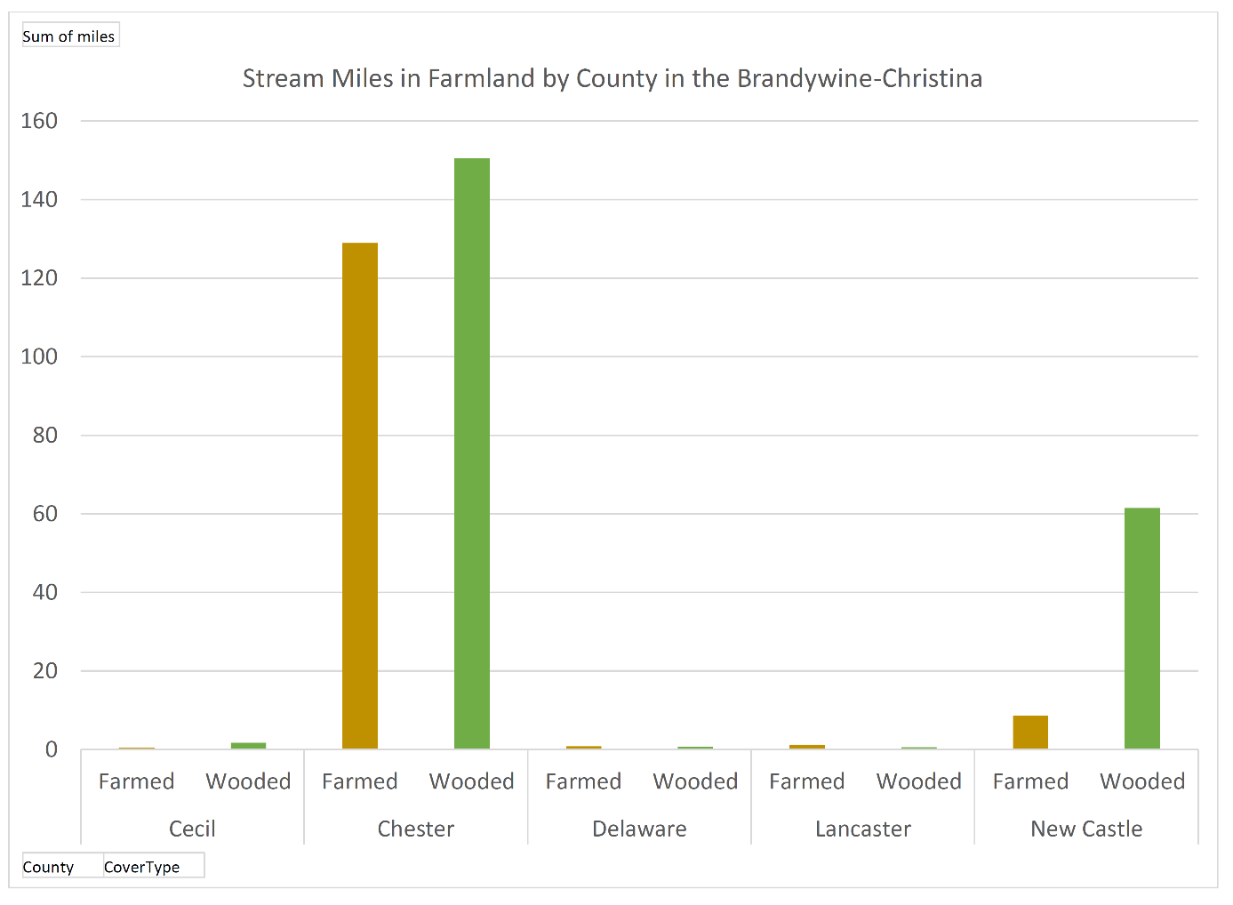
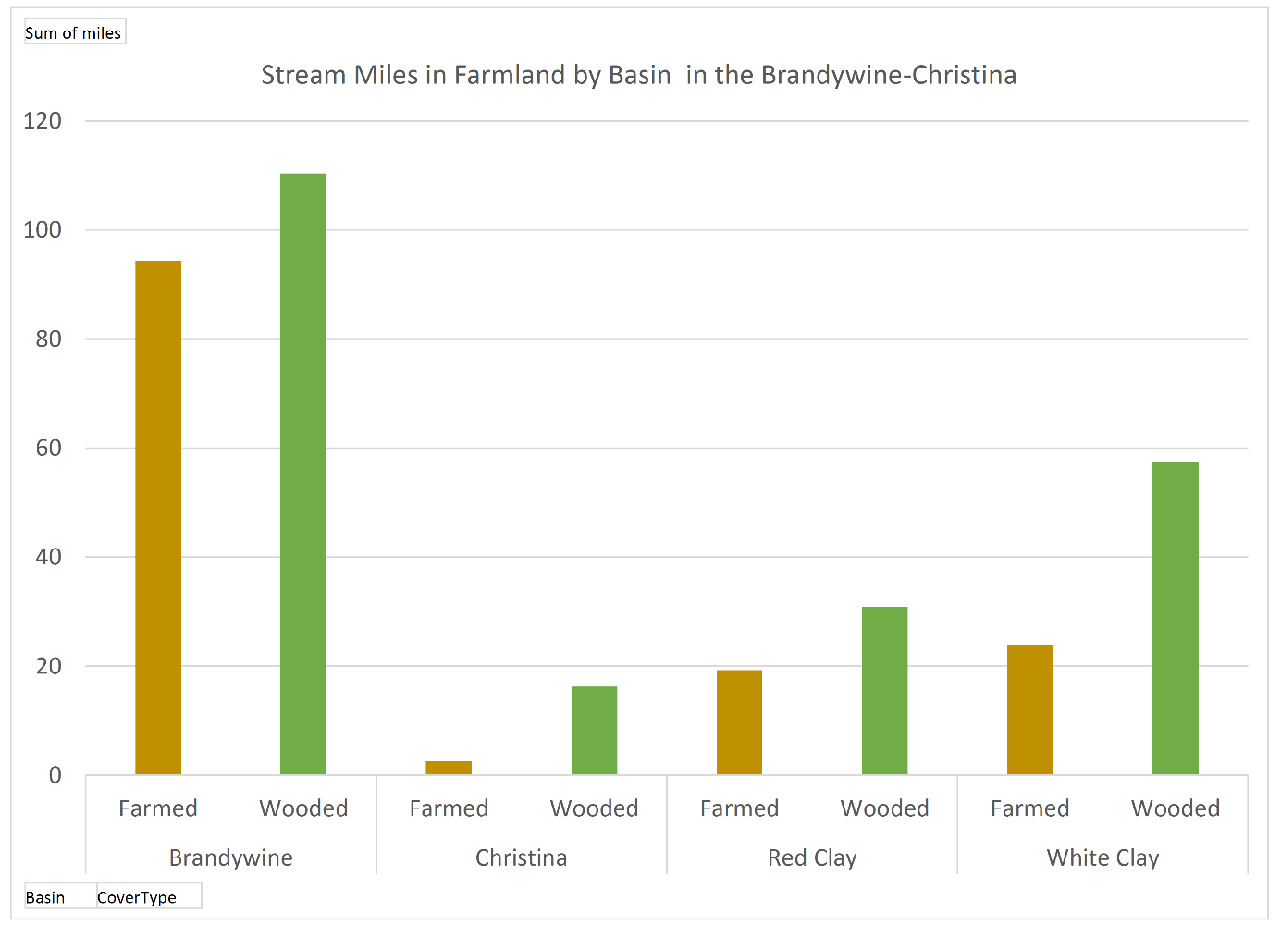

Slide 18
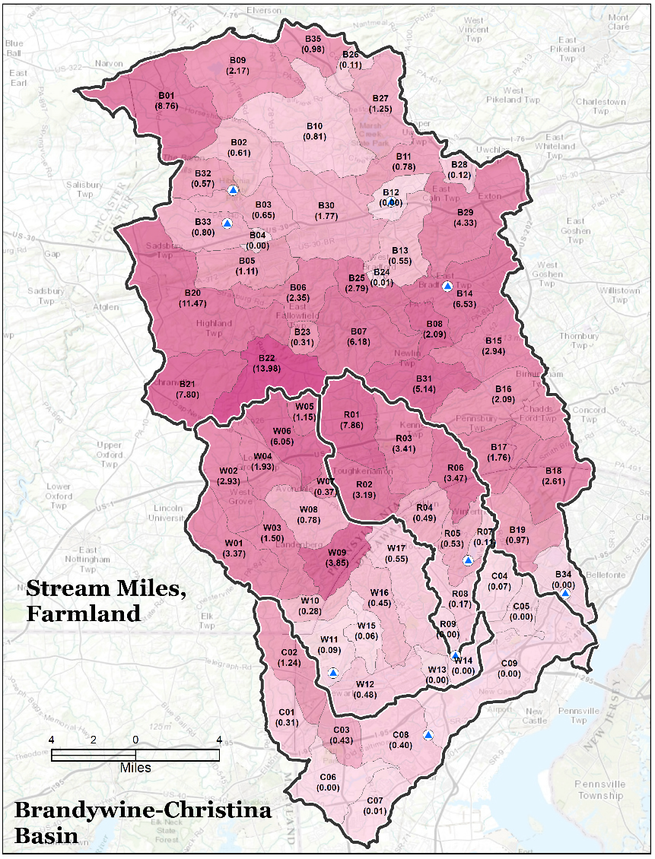
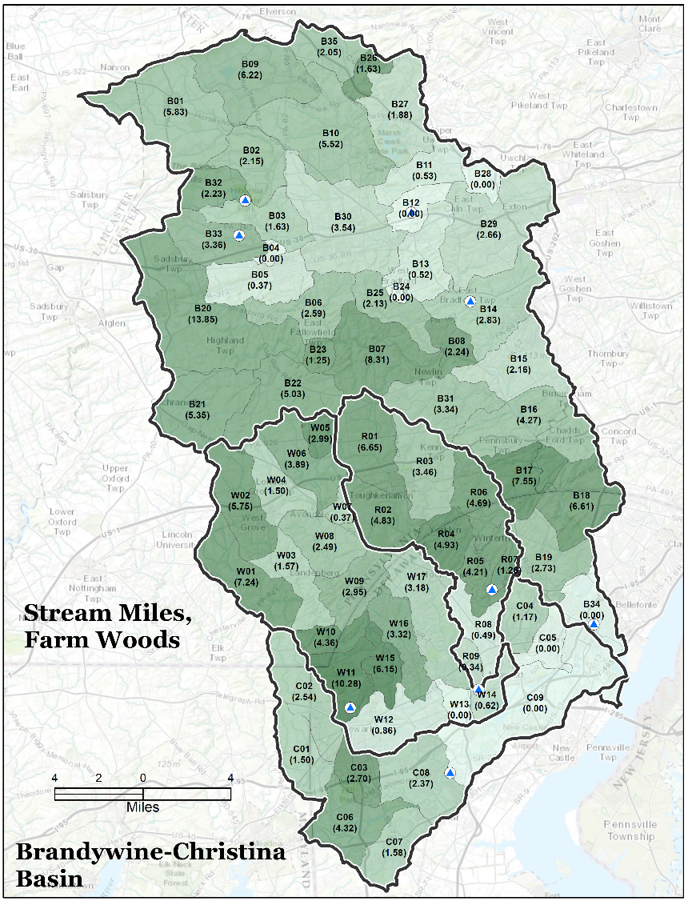

Slide 19
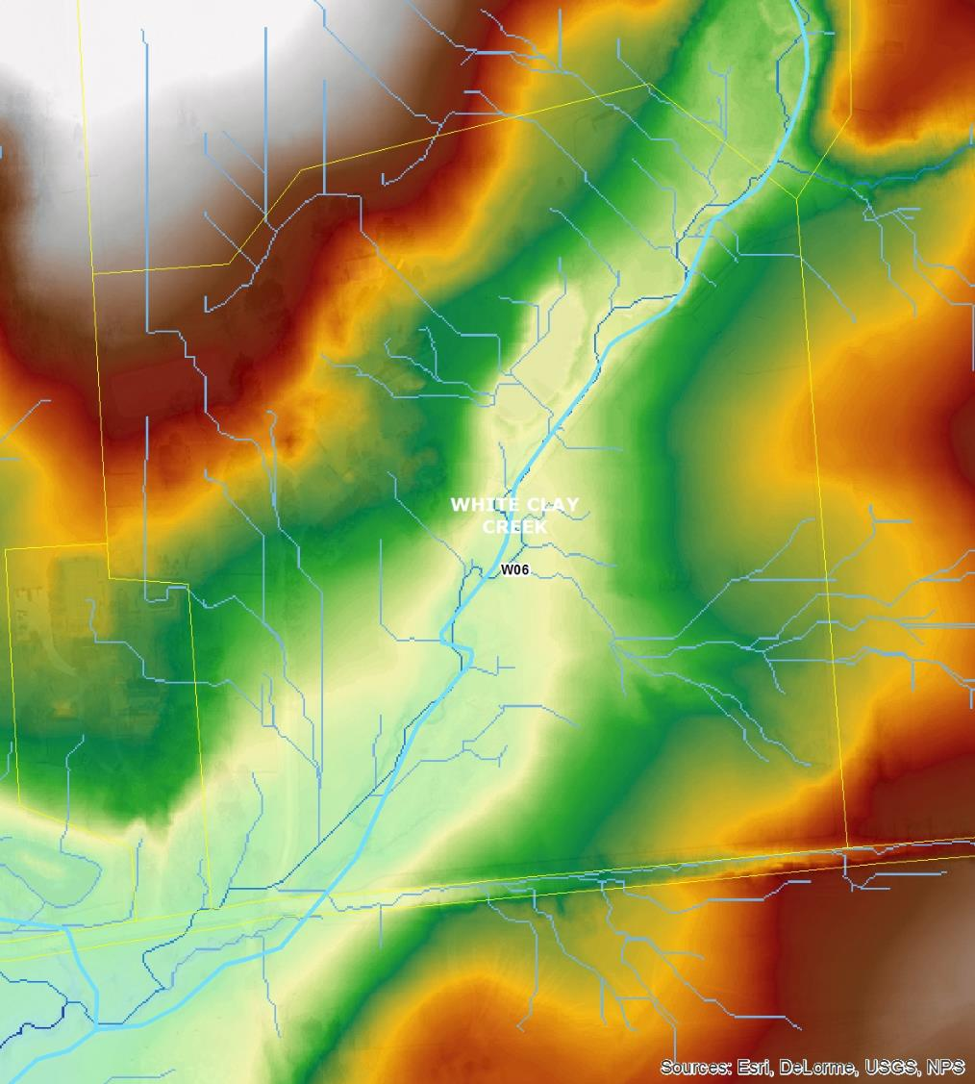
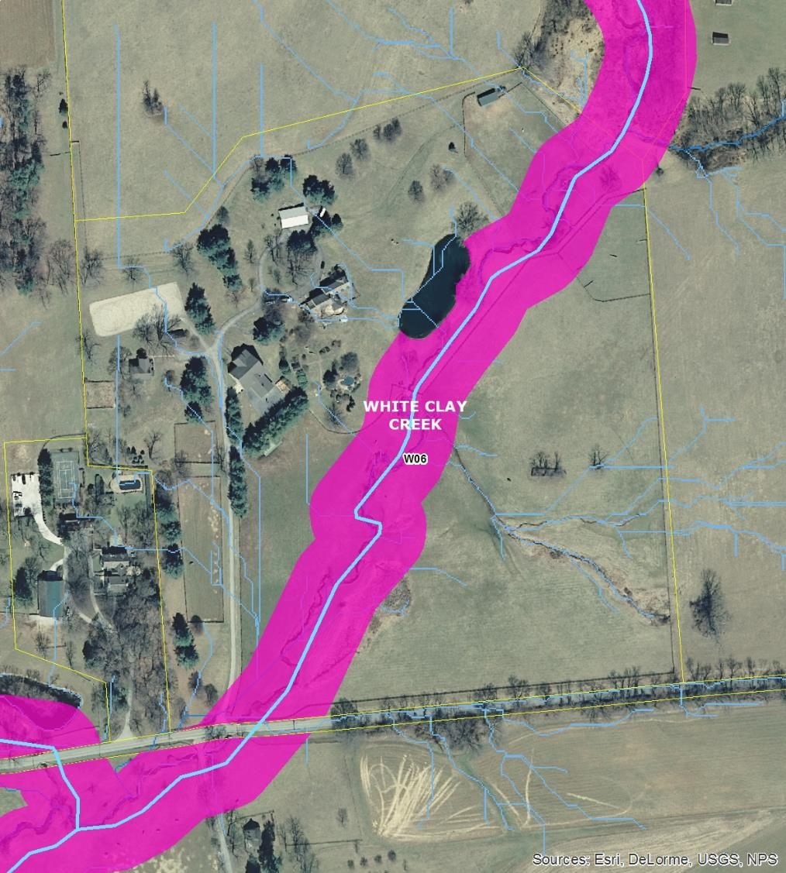
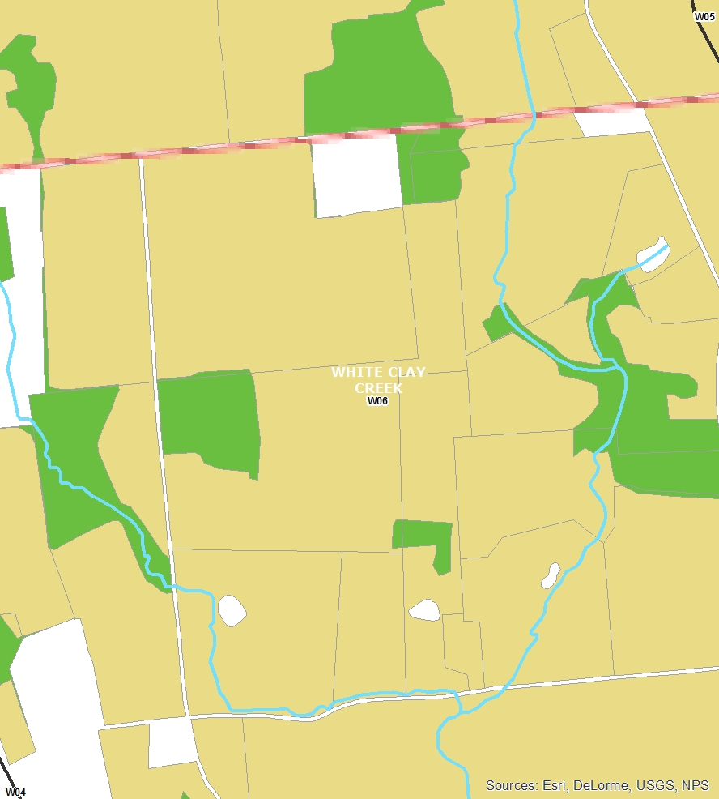
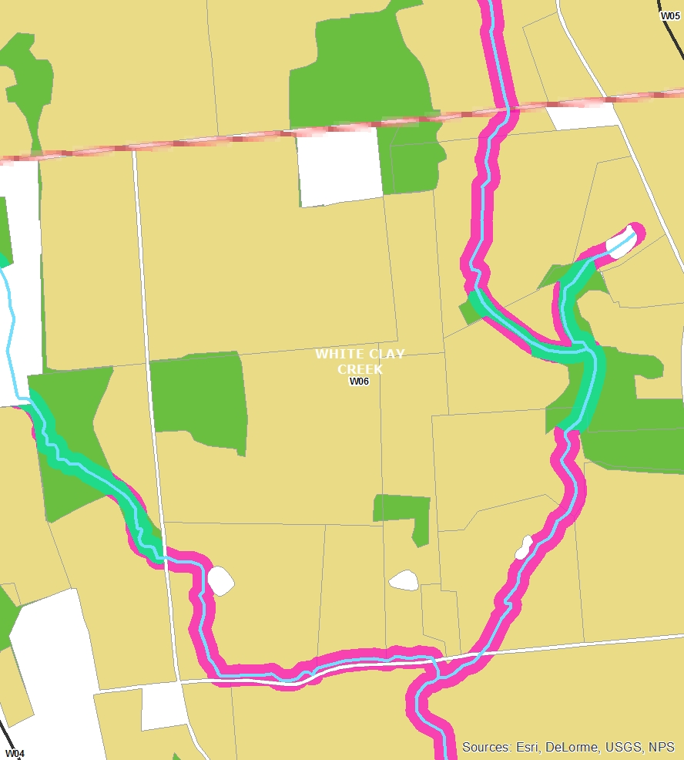
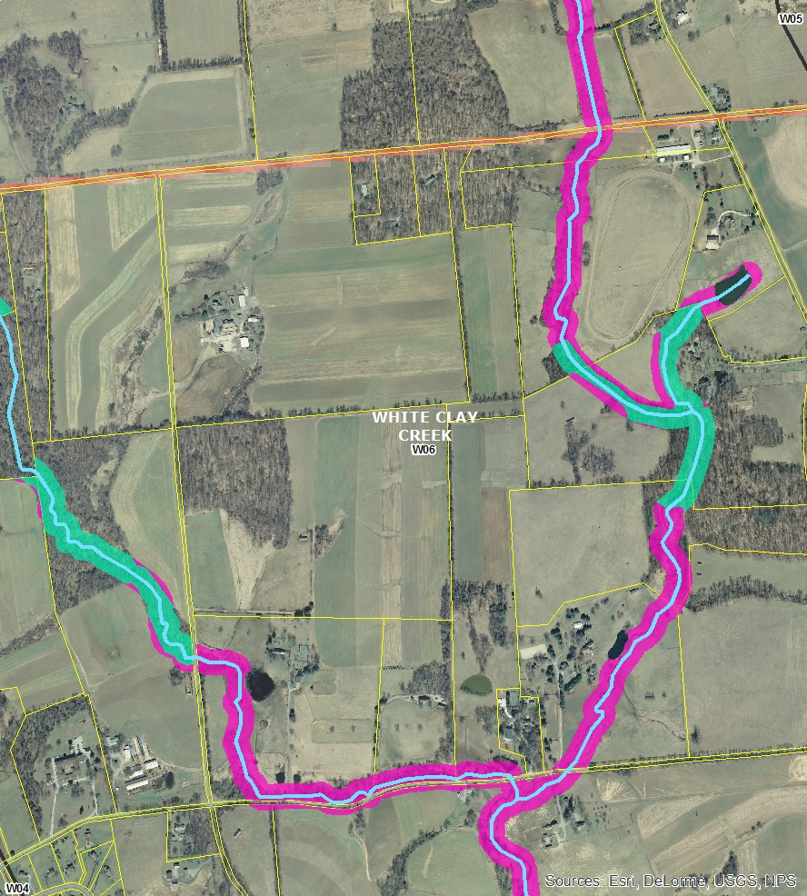
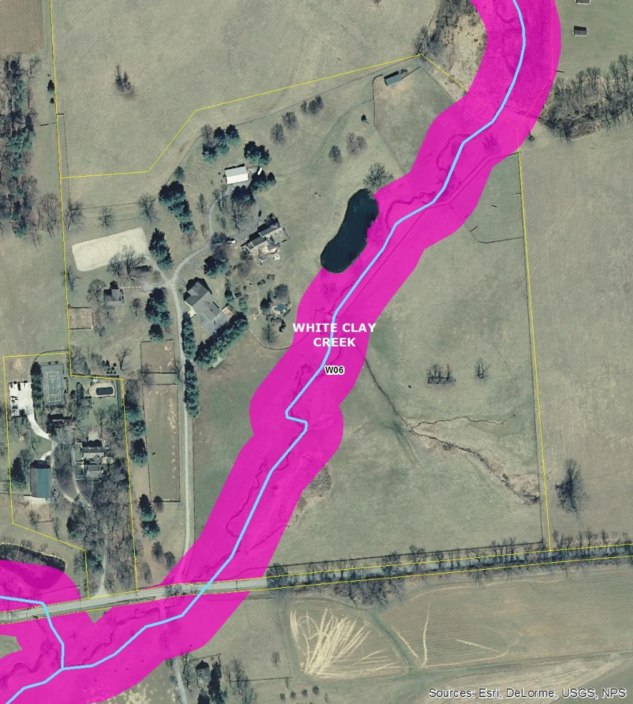

Slide 20
Total Estimated benefits by sector
Estimated benefits of improved water quality in the Brandywine-Christina cluster

Slide 21
3 - Costs (Red & White Clay)
Used calibrated MapShed model from CCWRA
Extended into non-Chester County portions
Created basin-wide load estimates
Developed scenarios by sub-shed
Derived
  Total BMP costs
  Constituent unit reduction costs
  Cost to reduce to target levels

Slide 22
Estimates from feasibility study

Slide 23
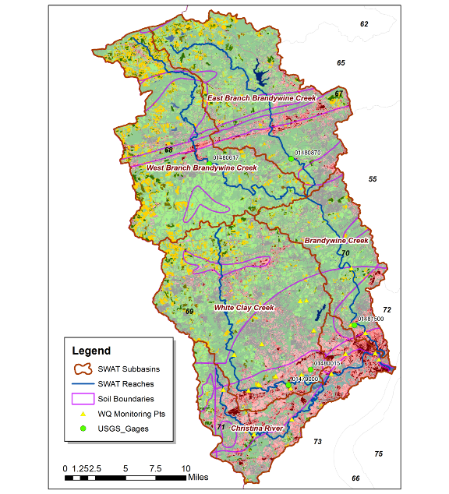
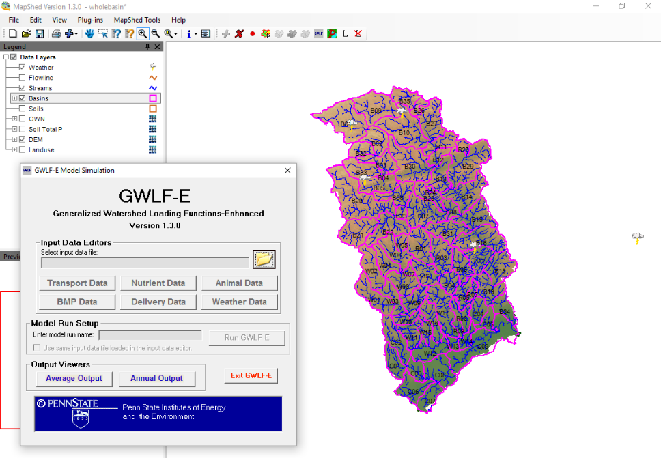
MapShed analysis
SWAT
Barry Evans/PSU, Water Resources
Authority of Chester County
Center for Naval Analyses

Slide 24
Sources
MapShed estimates

Slide 25
Yields by Land Cover
Sources
MapShed estimates

Slide 26
MapShed BMPs
Cover crops
No till/Conservation tillage
Nutrient management
Riparian buffers
Stream fencing

Slide 27
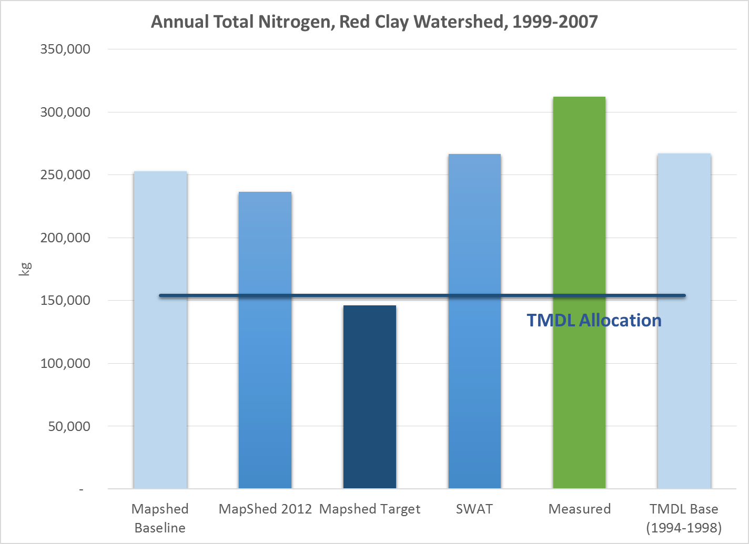
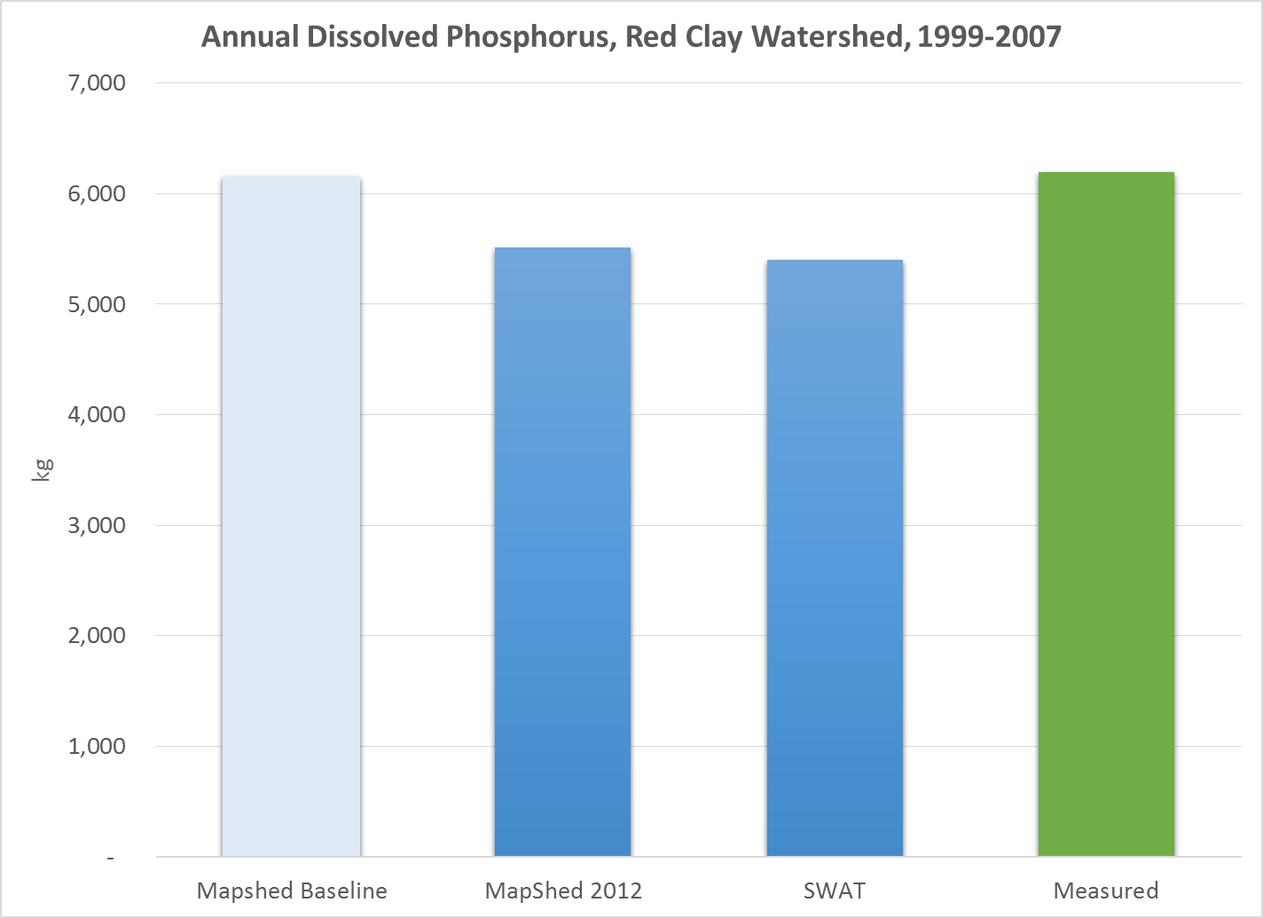
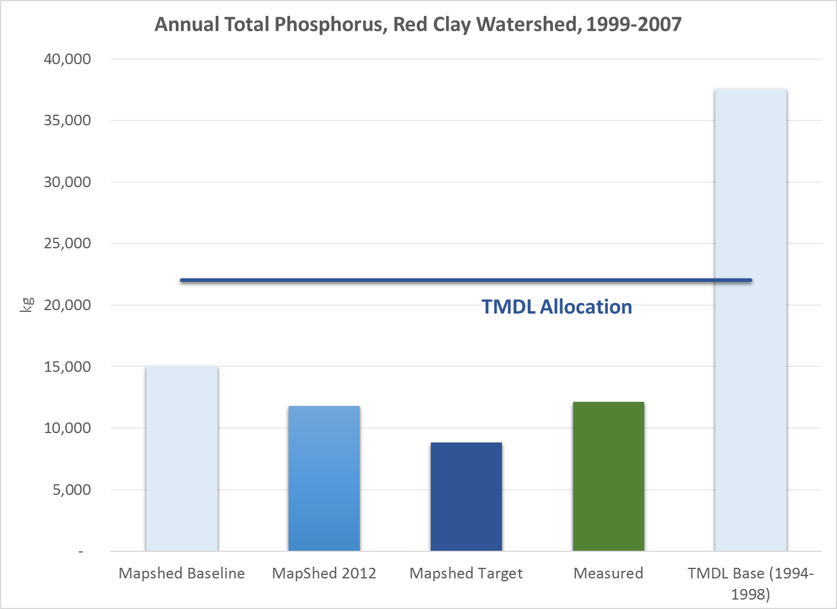
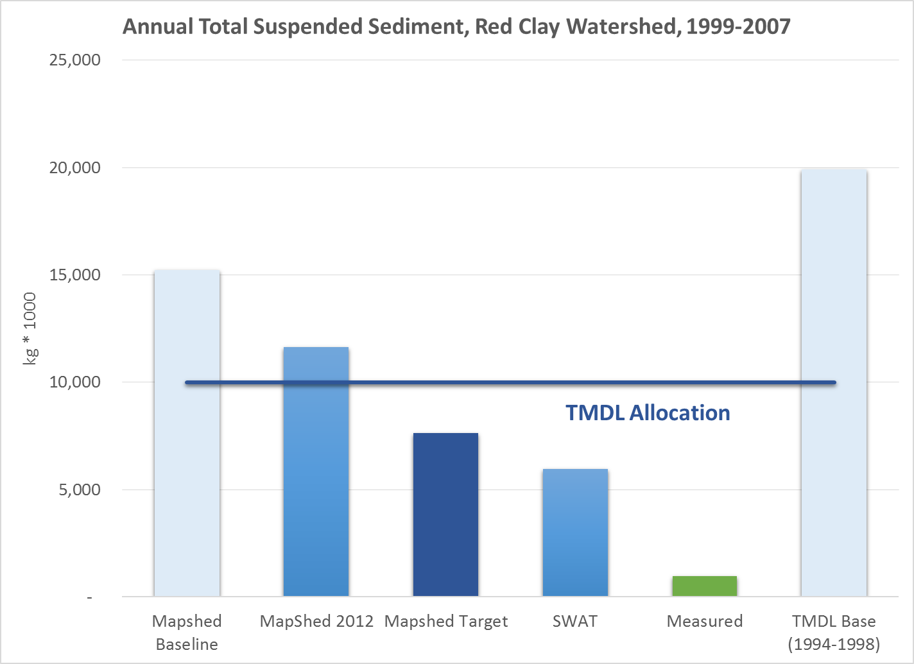

Slide 28
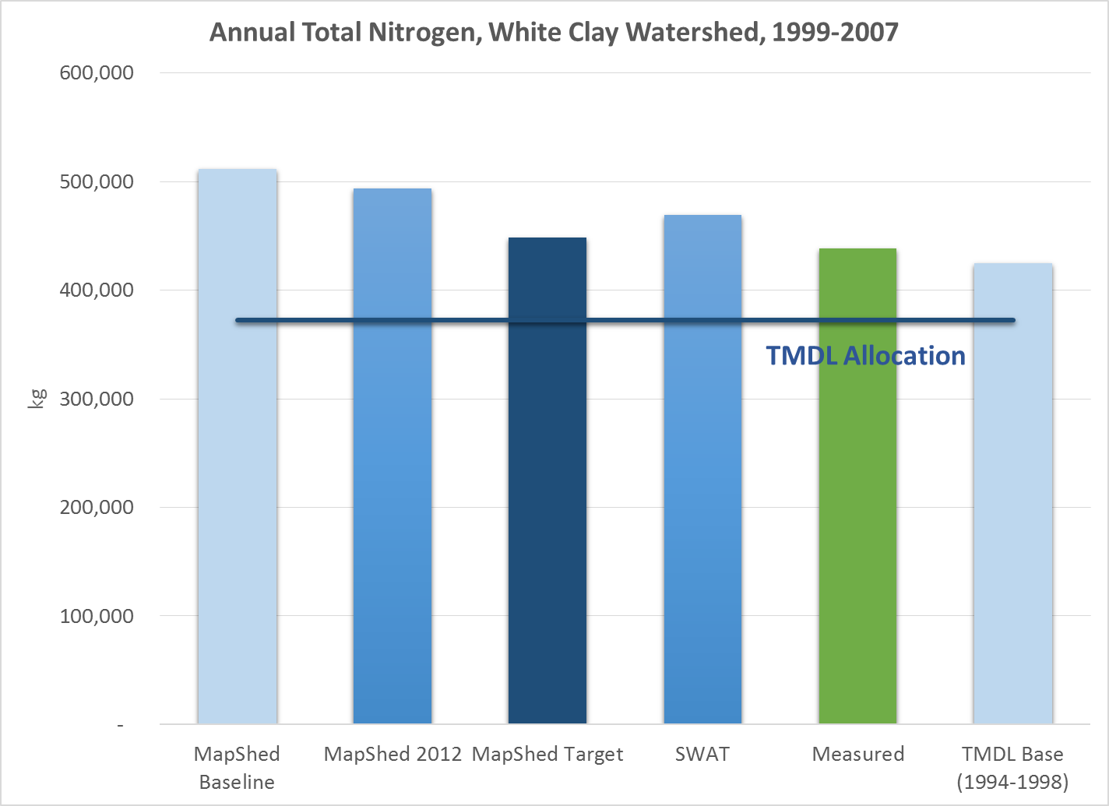
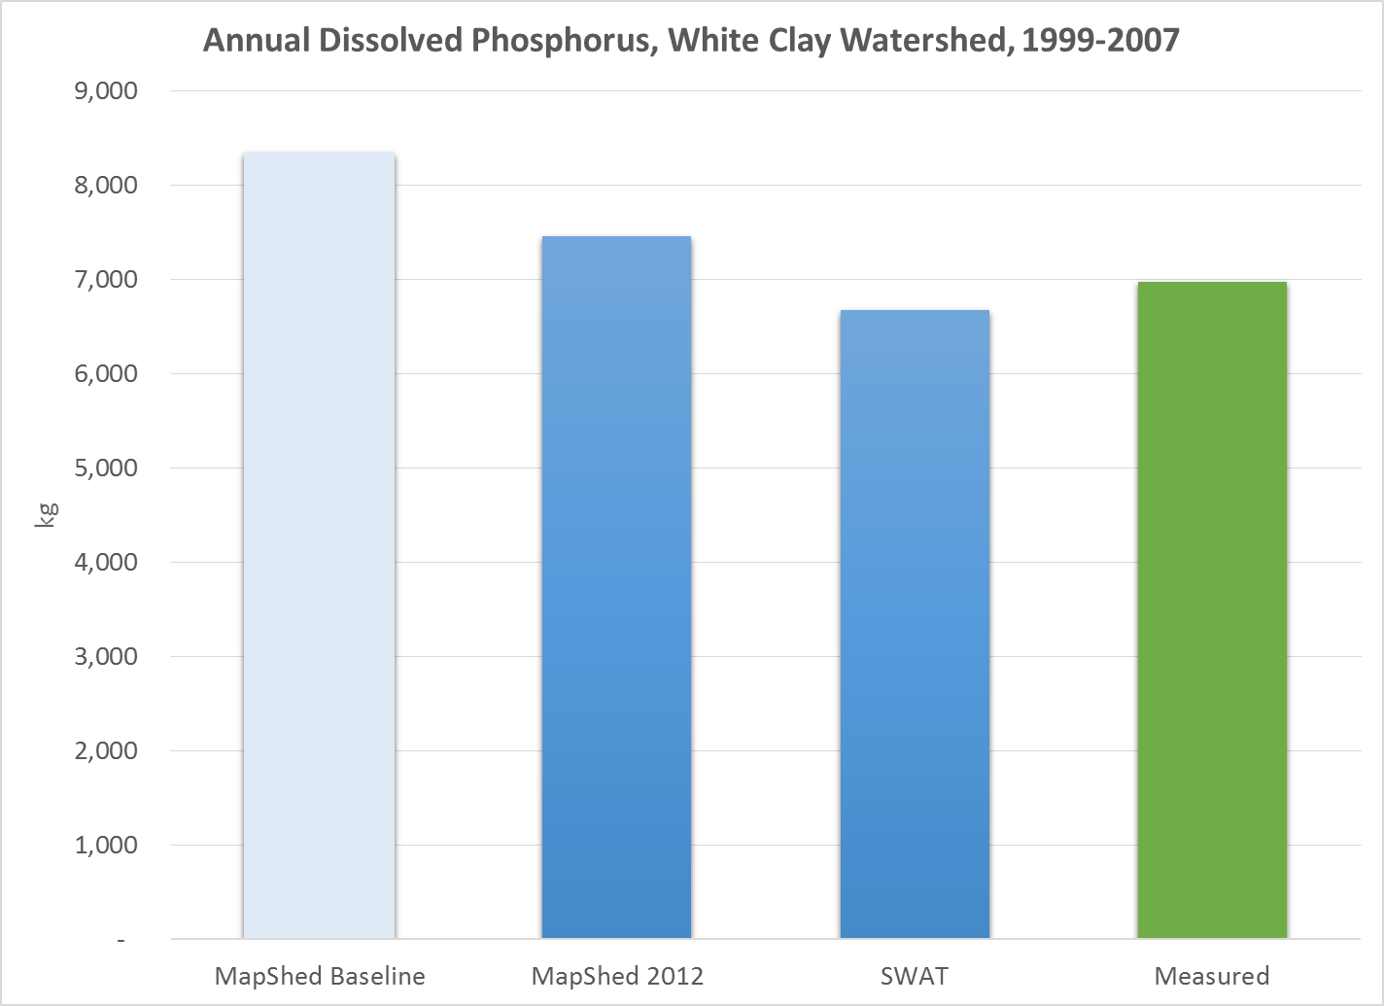
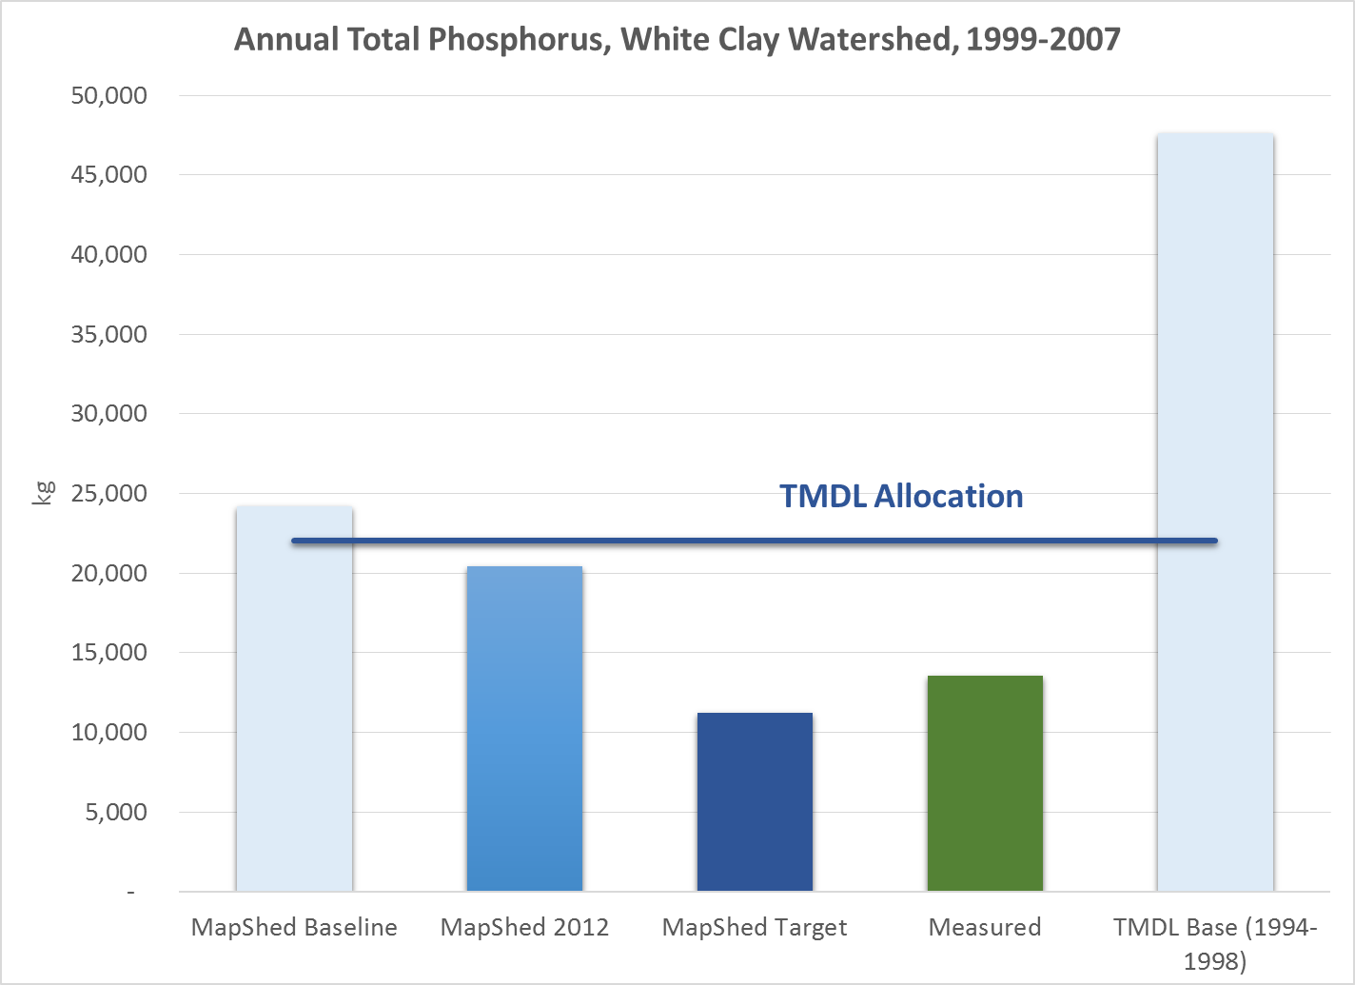
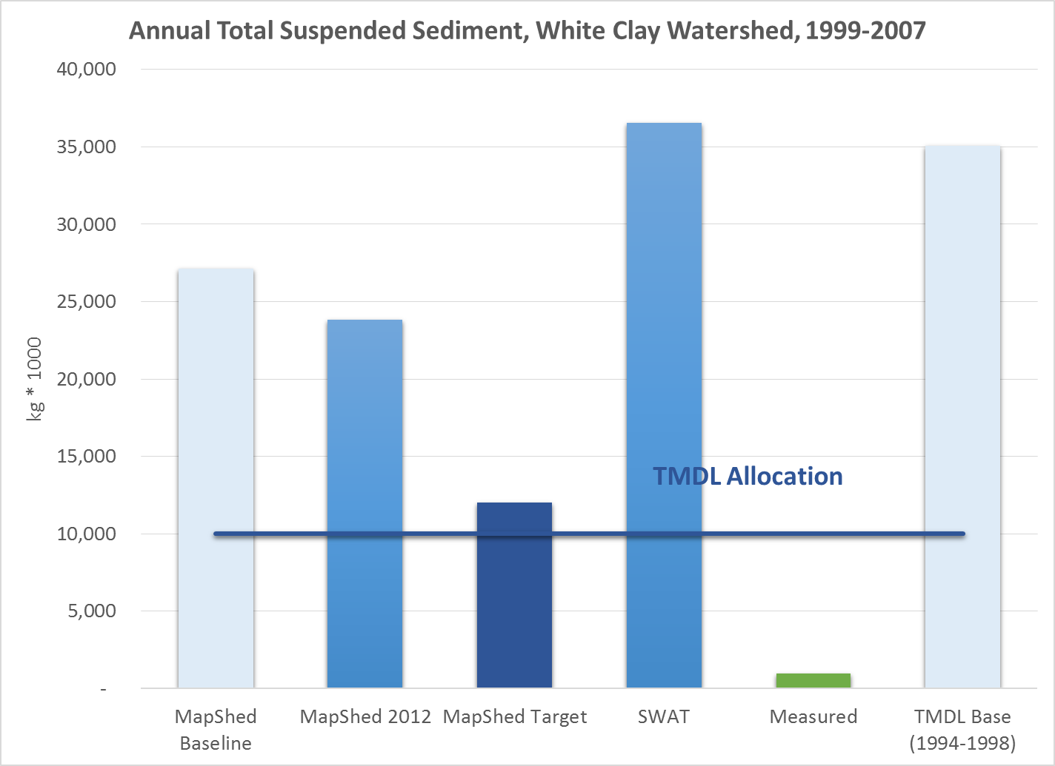

Slide 29
Costs to targets
Red Clay Creek Watershed
White Clay Creek Watershed

Slide 30
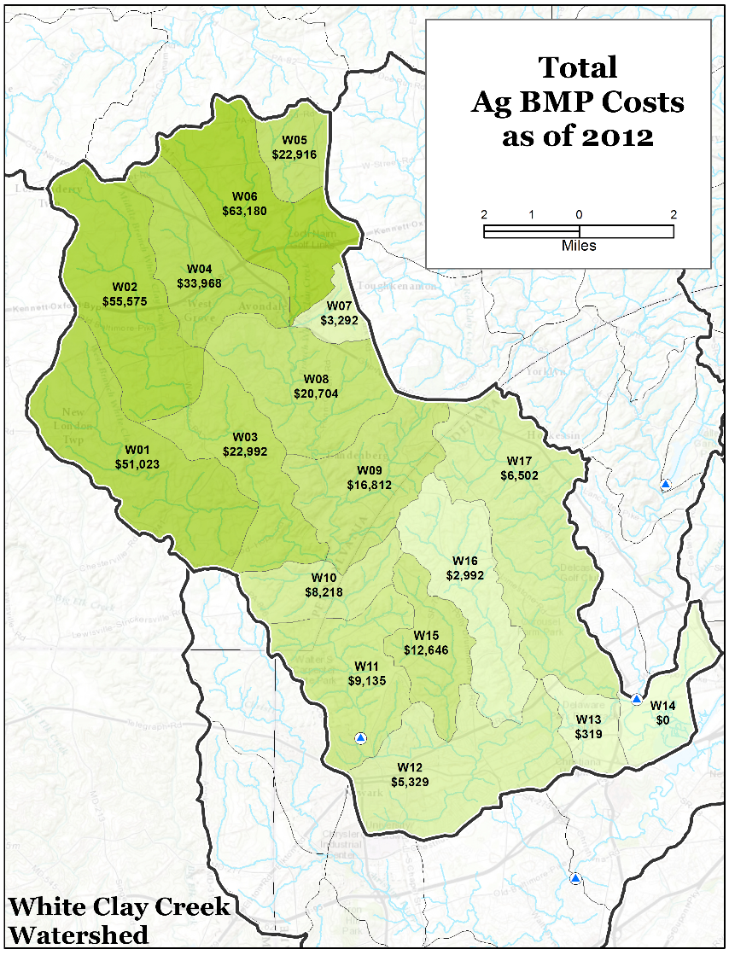
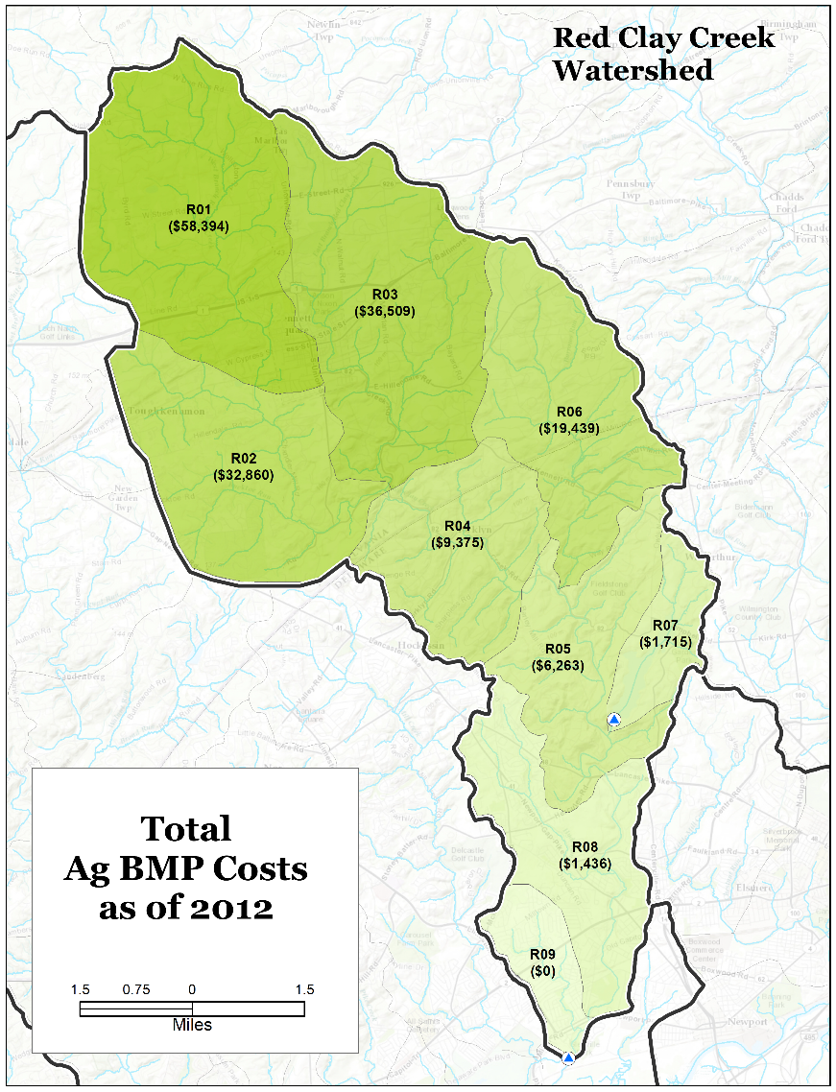

Slide 31
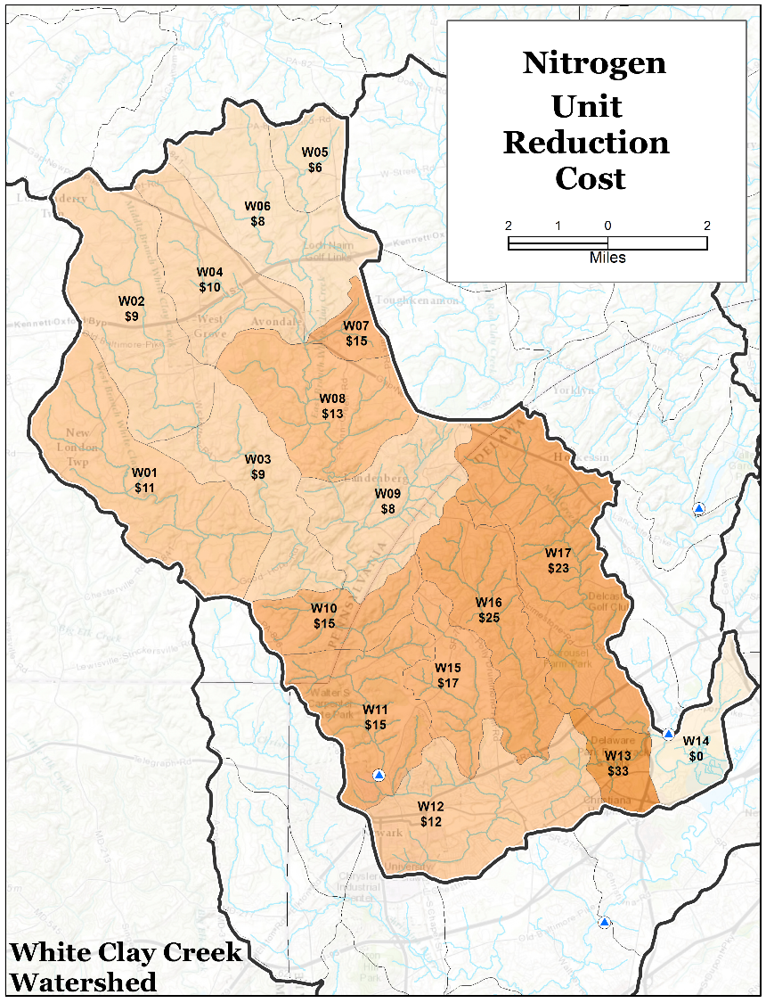
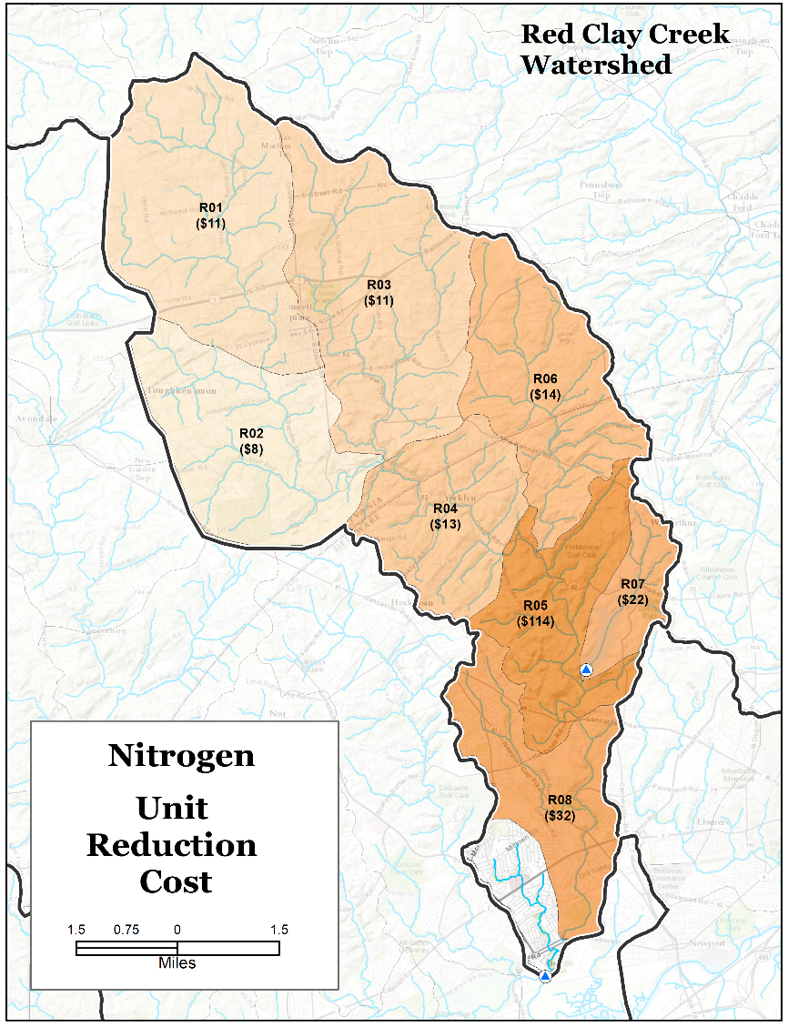

Slide 32
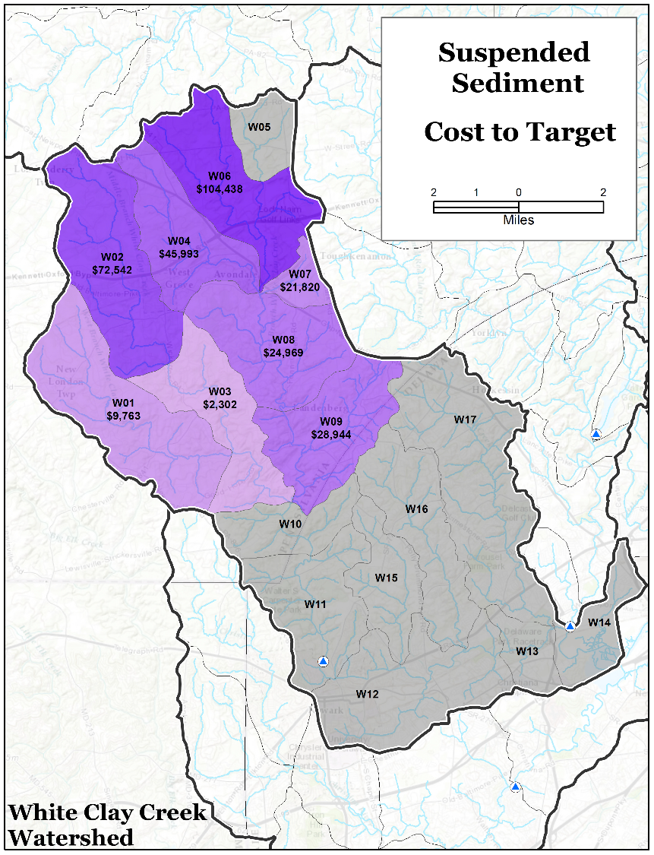
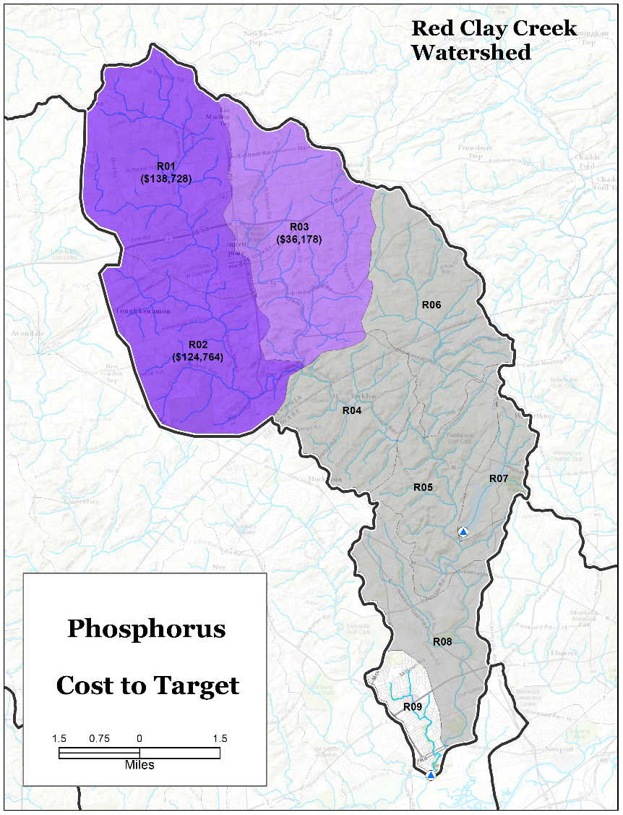

Slide 33
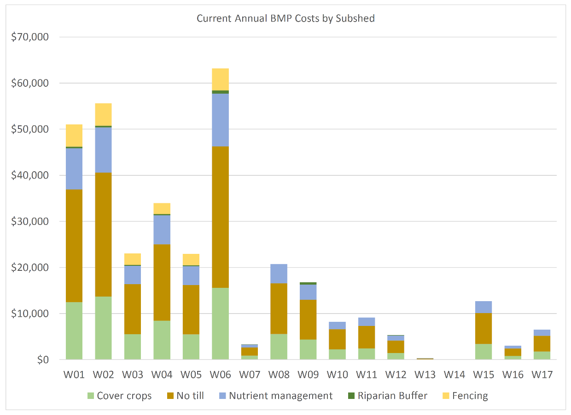
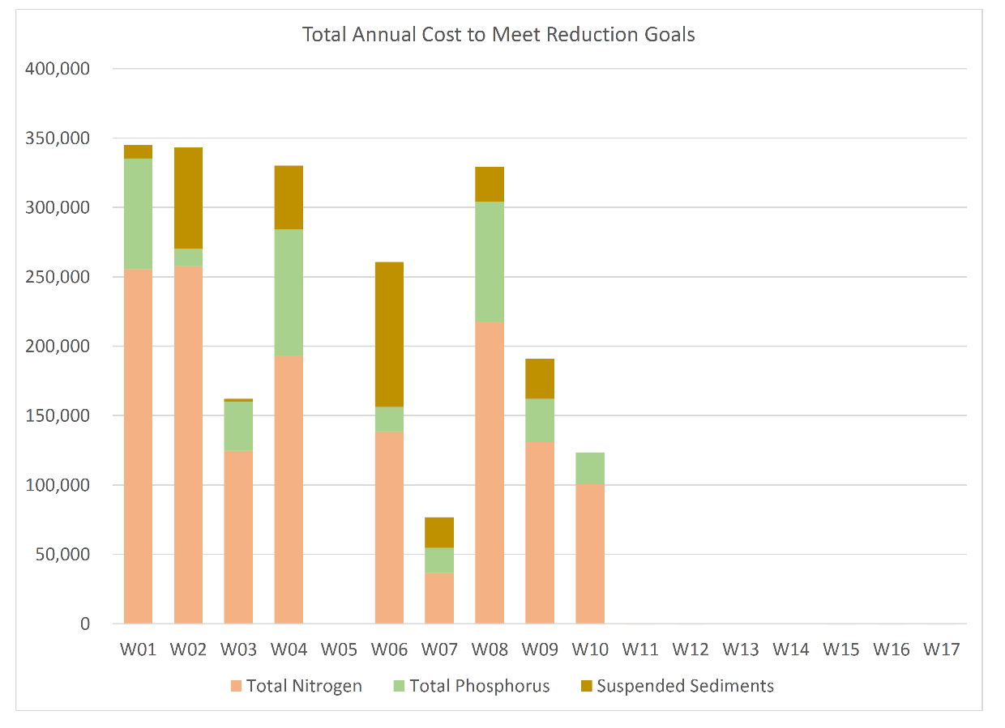
* Cost figures for riparian buffers and stream fencing include land rent values

Slide 34
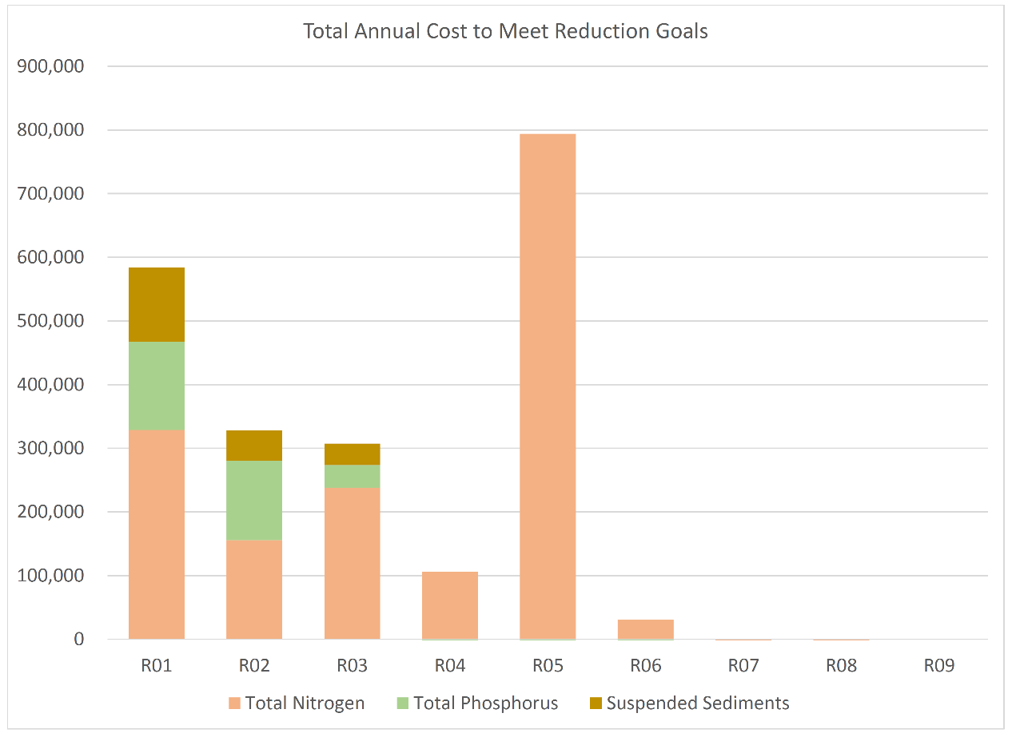
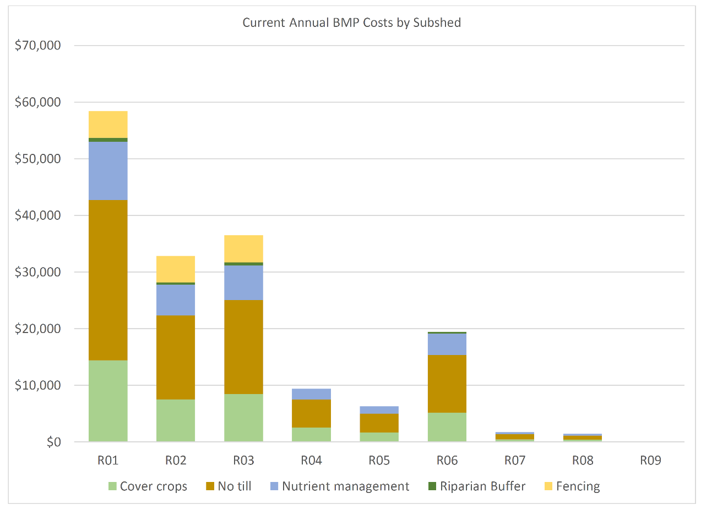
* Cost figures for riparian buffers and stream fencing include land rent values

Slide 35
Benefits:
Estimates from feasibility study
Assumes 4% decrease in sediment load can decrease water treatment costs by 1%.

Slide 36
4 - InVEST/RIOs

Slide 37
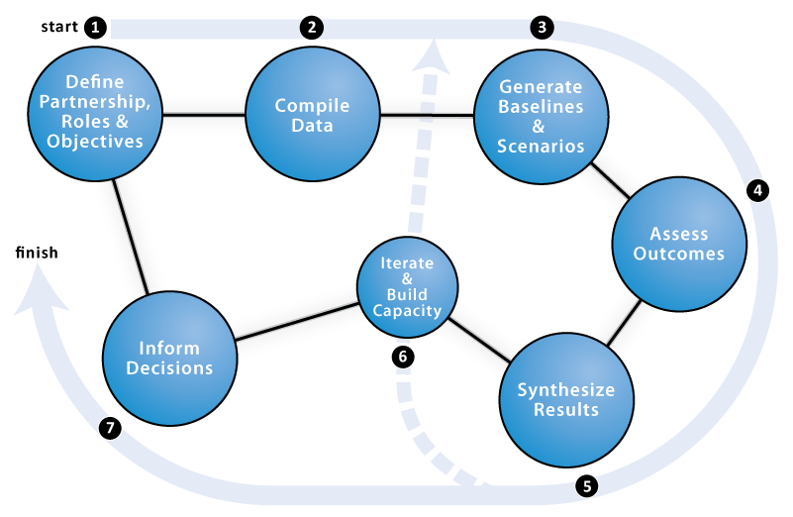


Planning Context
Notes:
RIOS prioritizes areas for PWS based on relative scoring of potential ES impacts, which can help target payments across landscapes. InVEST can quantify ES in biophysical terms (e.g. cubic meters of water), which can help to identify service providers and beneficiaries. It can also estimate economic values, in dollar terms, using a range of techniques e.g. avoided damage or treatment costs and market valuation. Valuation can only be completed once the biophysical parts of the models are calibrated to time series data. Given the simplifications in the biophysical and economic models, economic values should be treated as first estimates only, e.g. for gaining support for PWS.

Slide 38
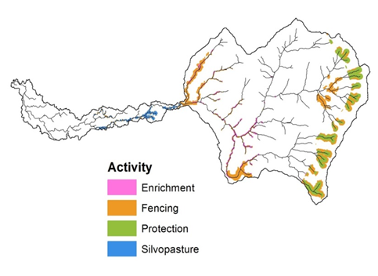
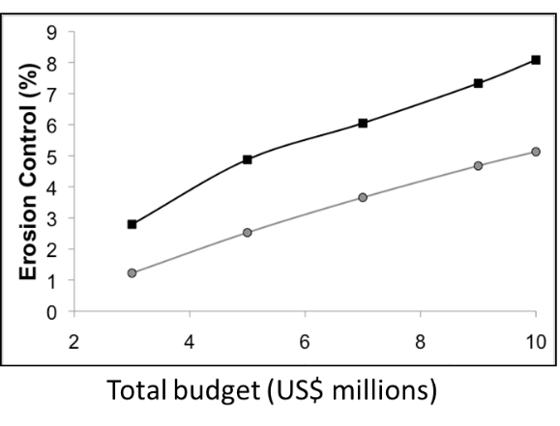
Resource Investment Optimization System (RIOS)
GOALS
Guide investment in watershed services within budget
Maximize investment for improvement in multiple services
QUESTIONS
Which activities are most cost-effective?
Where should I do them?

Slide 39

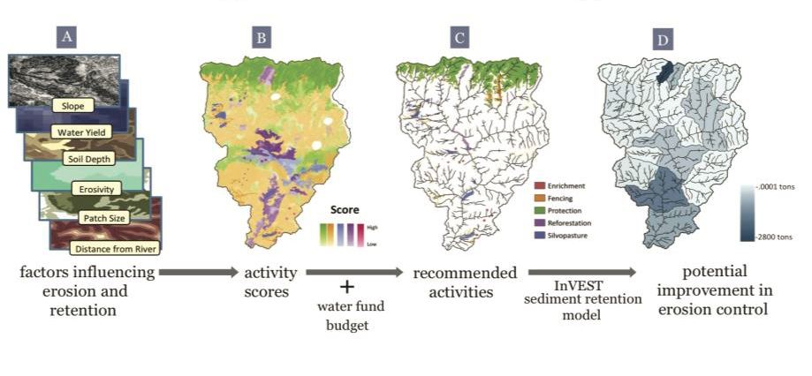
Integrated Valuation of Ecosystem Services and Tradeoffs (InVEST)
GOALS
Map and value the goods and services from nature
Assess quantified tradeoffs associated with alternative management choices
Example
Cauca Valley, Colombia

