Slide 1
Toward a model-based approach to water quality improvement in the Brandywine-Christina Cluster
Watershed-based return on investment
Andrew Homsey & Jerry Kauffman (UD) | Brian Boutin (TNC)
Natural Lands Trust | Cheslen Preserve | September 22, 2015

Slide 2
Topics
Overview of the watershed
Current planning and priorities
Existing modeling approaches (HSPF/TMDL, SPARROW)
New modeling approaches, Red Clay example (SWAT, MapShed, etc.)
  Loads
  Sources
  Reductions and Costs
  Optimization
Discussion
  Watershed priorities
  Constituents of concern
  Suite of potential BMPs
  Other considerations

Slide 3
1 Overview
Intakes
Land Cover
Impaired Streams
Population

Slide 4
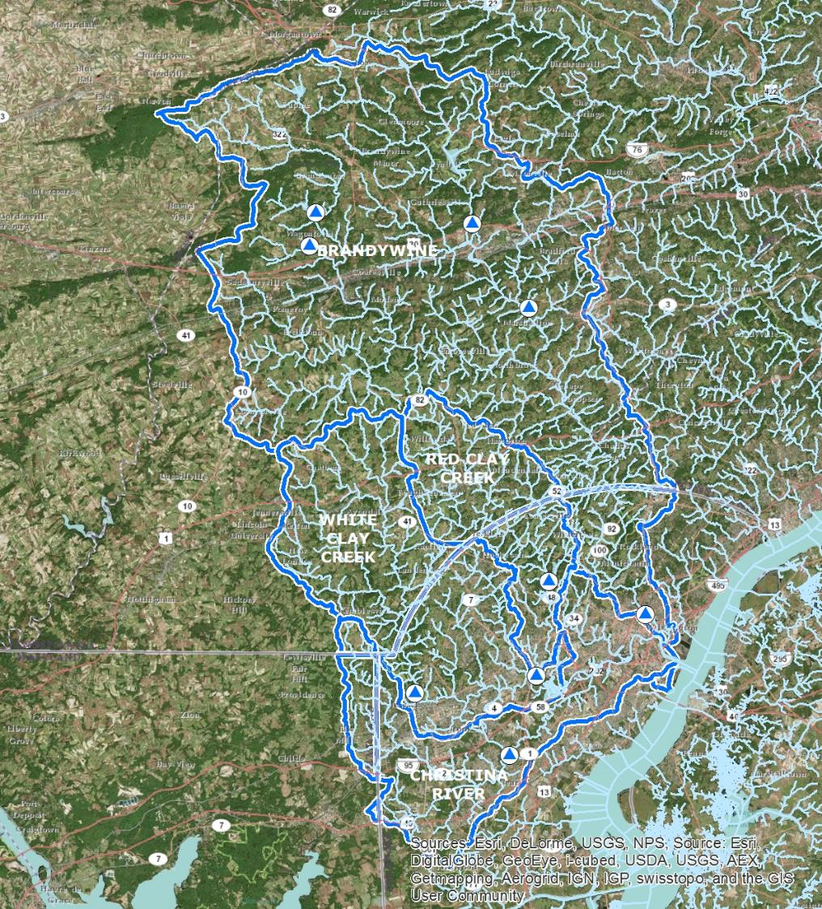

Slide 5
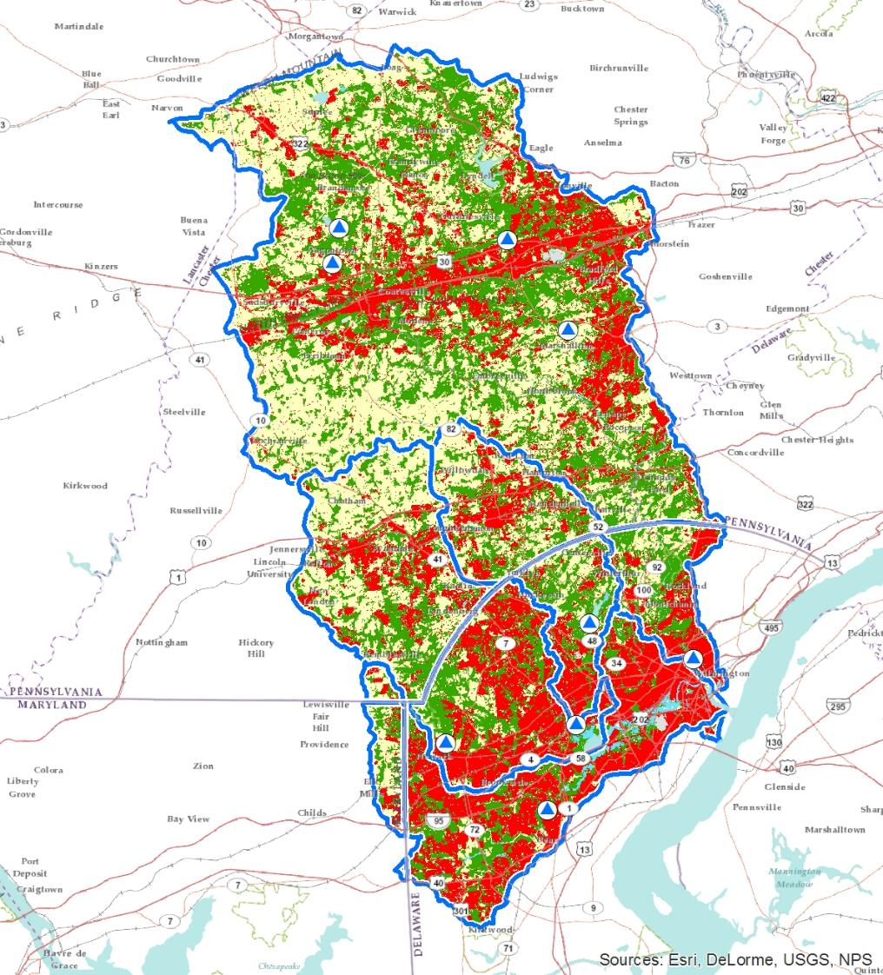

Slide 7
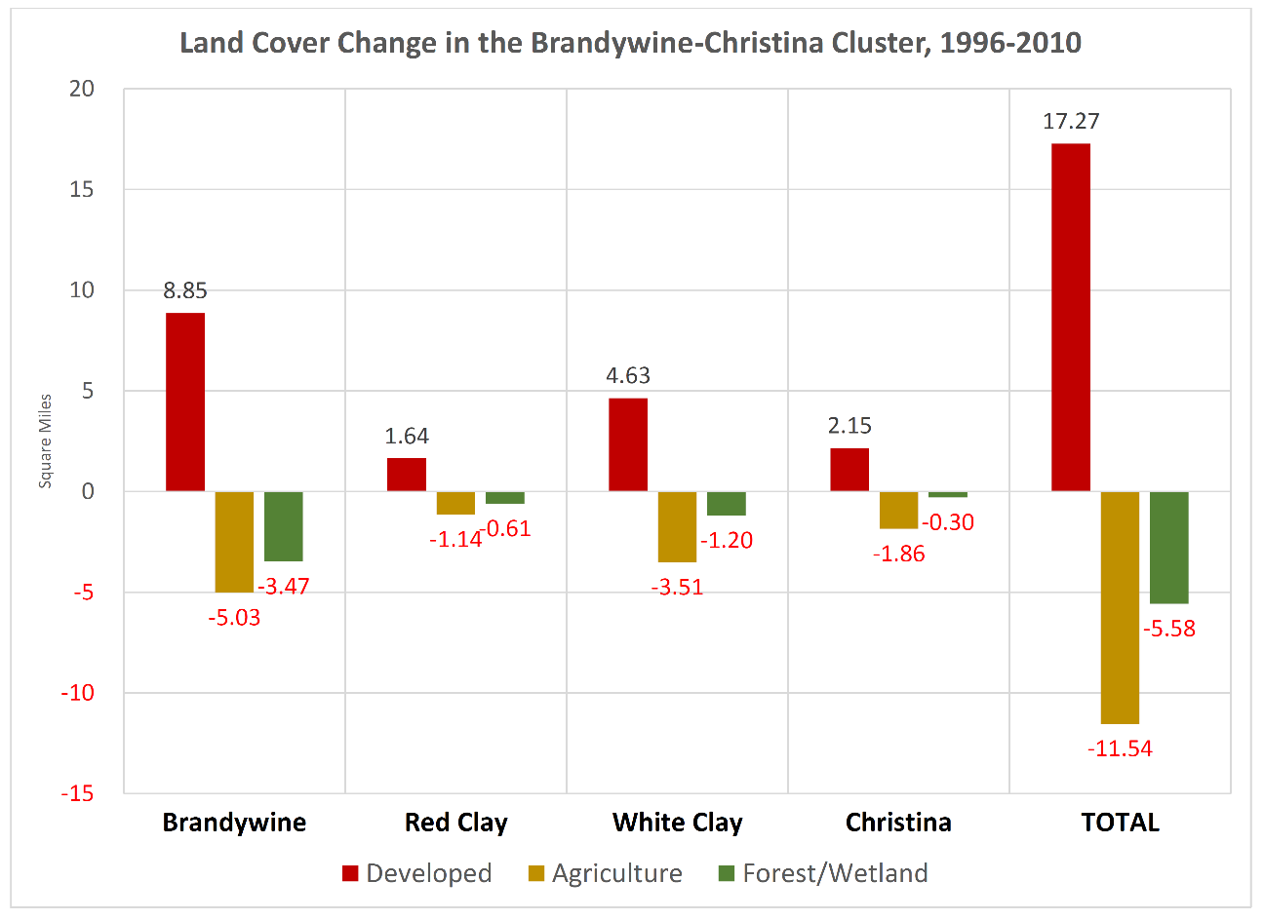

Slide 8
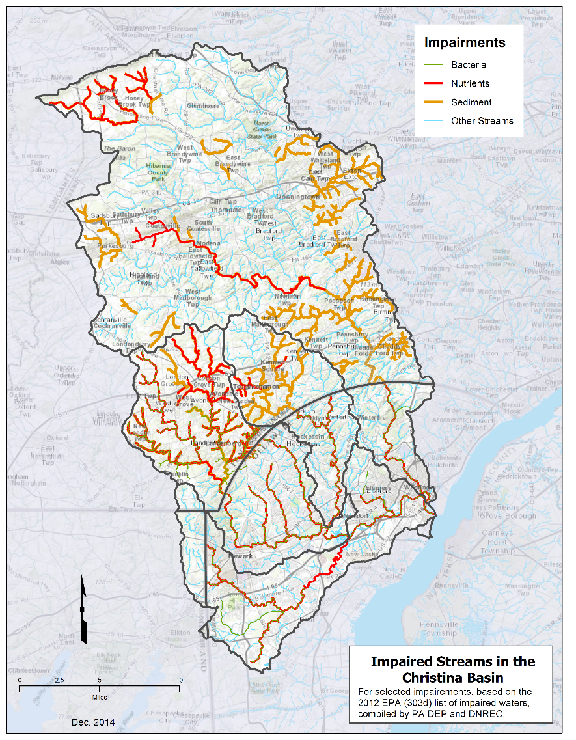

Slide 9
 | Square Miles | Population 2000 | Population 2010 | Population 2020 | Population 2030
Brandywine | 326.18 | 221,413 | 246,702 | 266,352 | 275,029
Christina | 77.09 | 166,435 | 174,196 | 177,600 | 180,659
Red Clay | 54.04 | 42,630 | 46,893 | 50,293 | 52,530
White Clay | 107.28 | 118,579 | 123,506 | 128,378 | 131,555
Whole Basin | 564.59 | 549,057 | 591,297 | 622,623 | 639,773

Slide 10
Meeting goals
Begin conversation about approaches to leveraging funding
Understand how to fit into existing strategies/plans by numerous groups
Determine a path to develop cost/benefit scenarios
Start to create a framework to efficiently and effectively get projects in the ground

Slide 11
2 A lot of planning is going on…
Christina Basin TMDL
BVA Red Streams Blue Restoration Plans (Upper West Branch (Buck Run, Plum Run, Valley Run, Radley Run, Shamona Creek)
Wilmington Source Water Protection Plan
Christina Basin DE PCS
Christina Basin PA Watershed Plans
Christina Basin TMDL implementation plan (CTIP)
Other Watershed Plans

Slide 13
Watershed Goals
Primary
  Water quality
Secondary
  Stormwater volume and velocity
  Habitat/environmental benefit
  Impaired stream delisting
  Recreation/social benefit

Slide 14
Constituents of Interest
Sediment
Nutrients
Bacteria
Turbidity
Chlorides

Slide 15
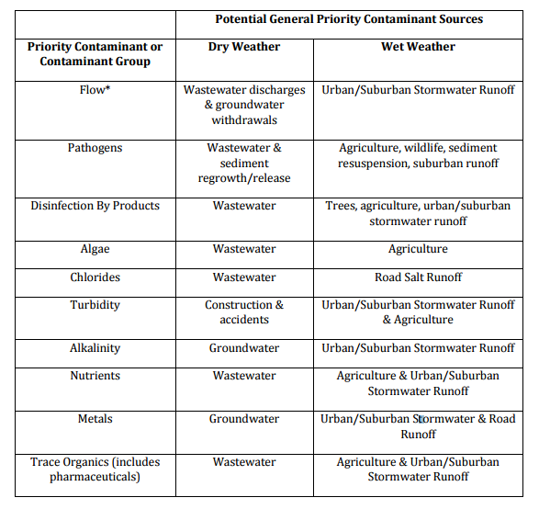
Wilmington Sourcewater Plan, 2010

Slide 16
C-TIP TMDL
implementation plan
(Gaadt Perspectives,
CCWRA, CCCD)

Slide 17
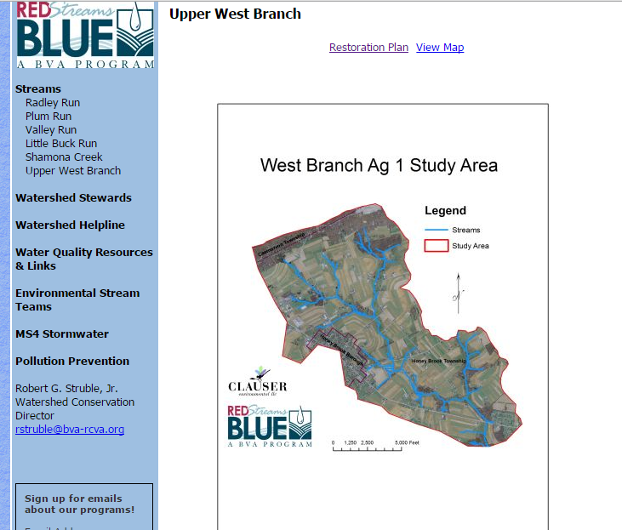

Slide 18
There are many priorities
CTIP
Cluster partners
TMDLs
Purveyors: Wilmington, United, Newark, Aqua, PA American, others
BVA, DNREC, DEP, CCWRA, CCCD, BC, Stroud, Watershed teams, WCU, Municipalities/MS4s, PDE, DNS, NLT, USACE
Coordination is key.

Slide 19
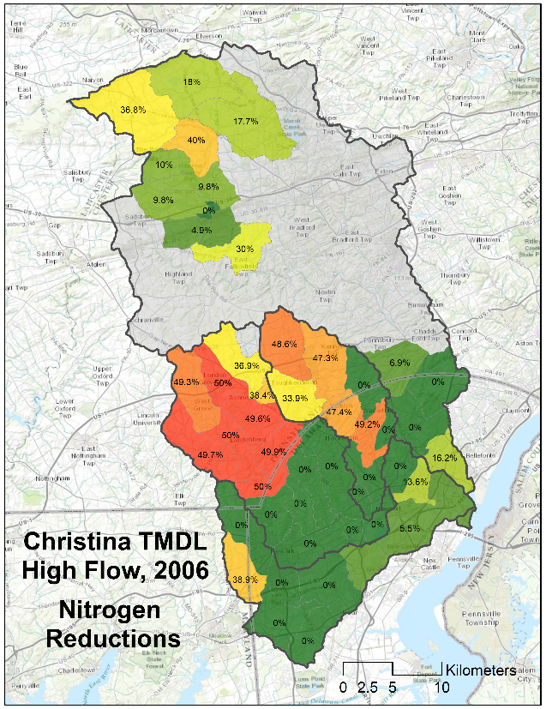
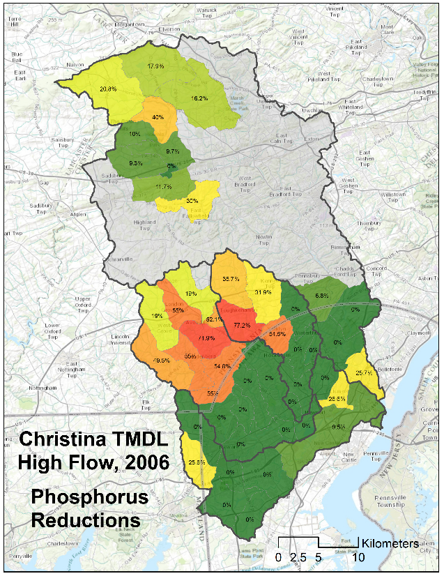
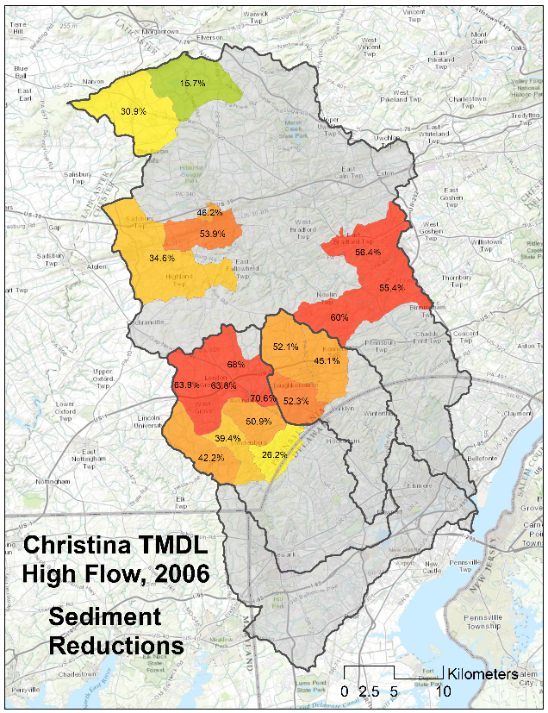
3 Existing models
TMDL, based on HSPF (1994-1998)

Slide 20
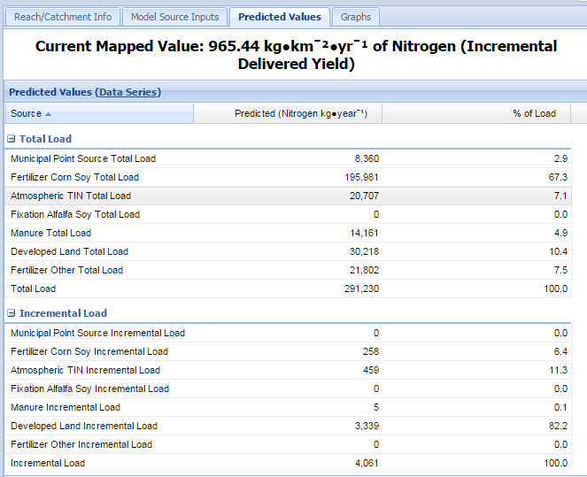
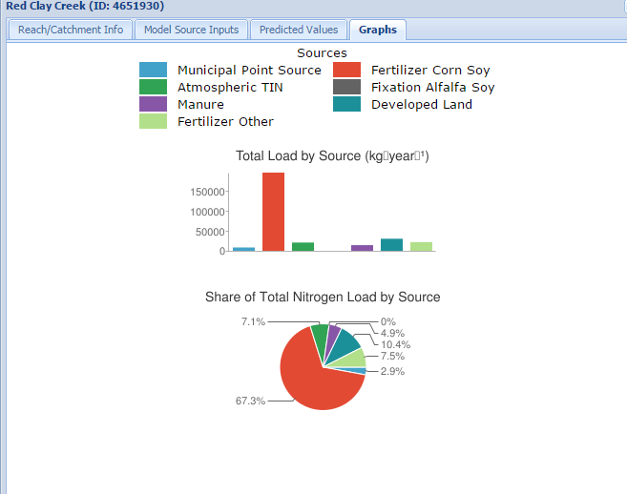
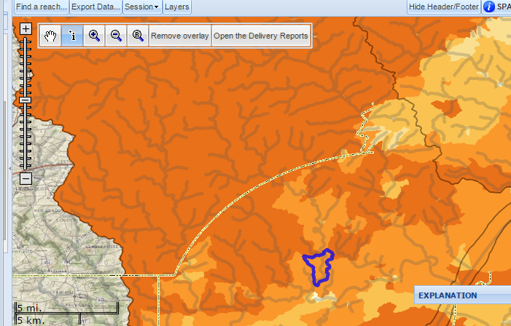
USGS SPARROW model: NITROGEN
Red Clay Creek Watershed

Slide 21
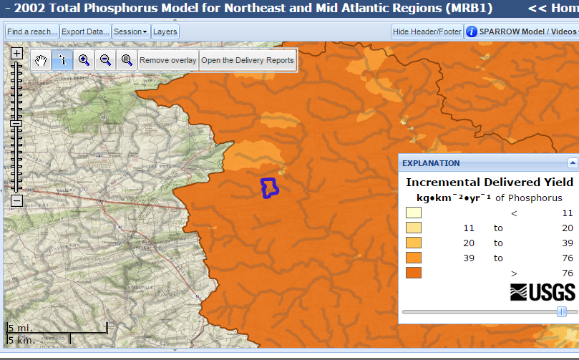
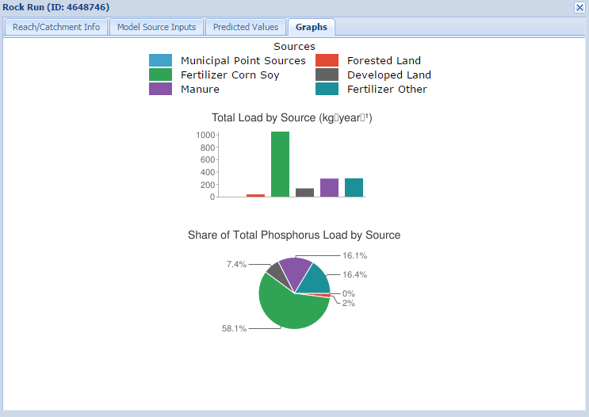
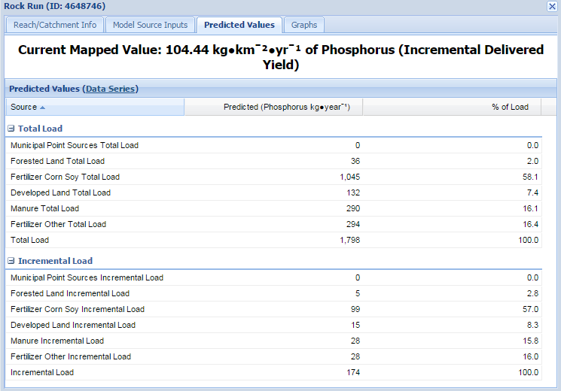
USGS SPARROW model: PHOSPHORUS
Rock Run

Slide 22
Feasibility Study—Economic Analysis

Slide 23
Cost Estimates from Economic Study

Slide 24
Estimates from feasibility study

Slide 25
Estimates from feasibility study
Assumes 4% decrease in sediment load can decrease water treatment costs by 1%.

Slide 26
Total Estimated benefits by sector
Estimated benefits of improved water quality in the Brandywine-Christina cluster

Slide 27
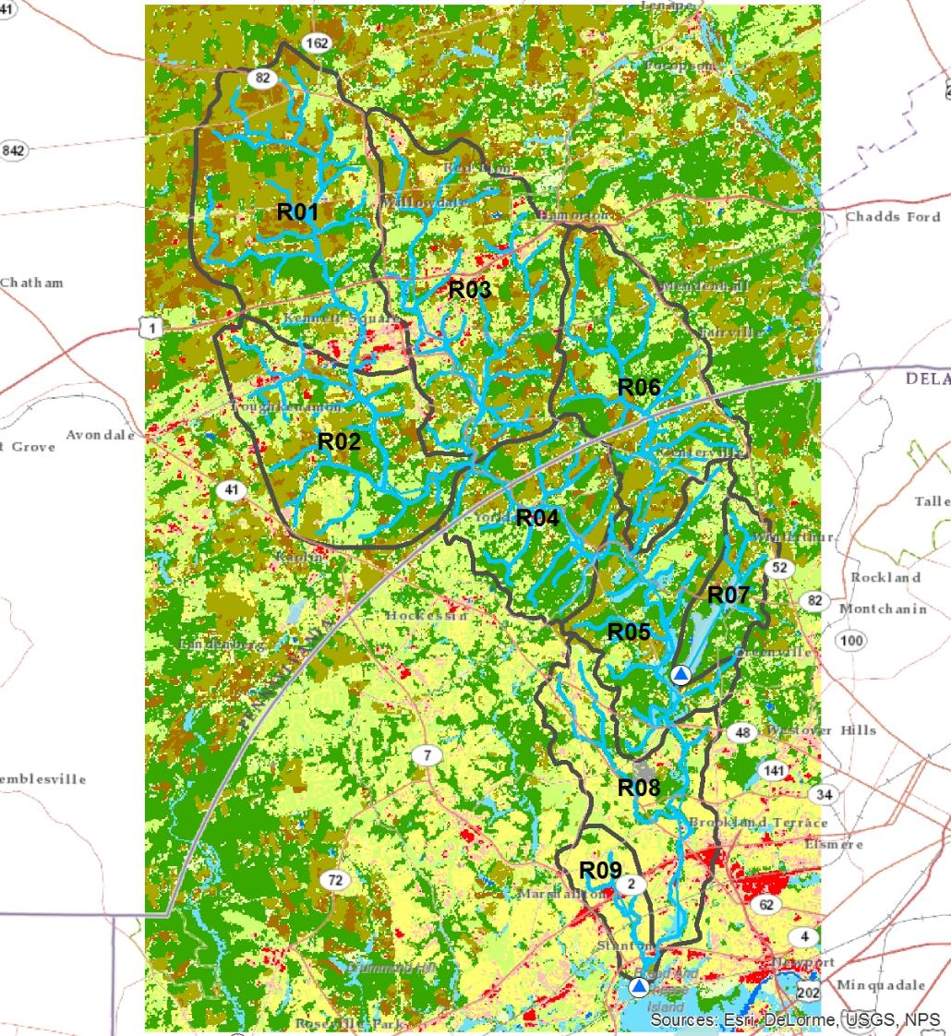
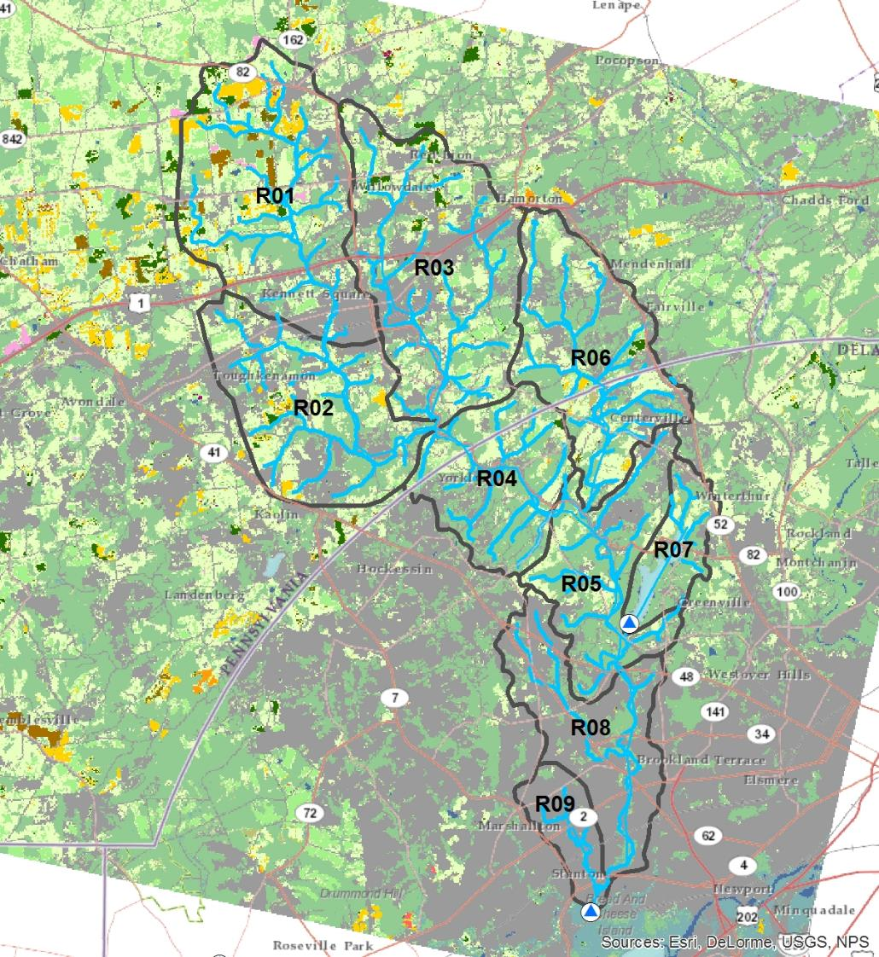
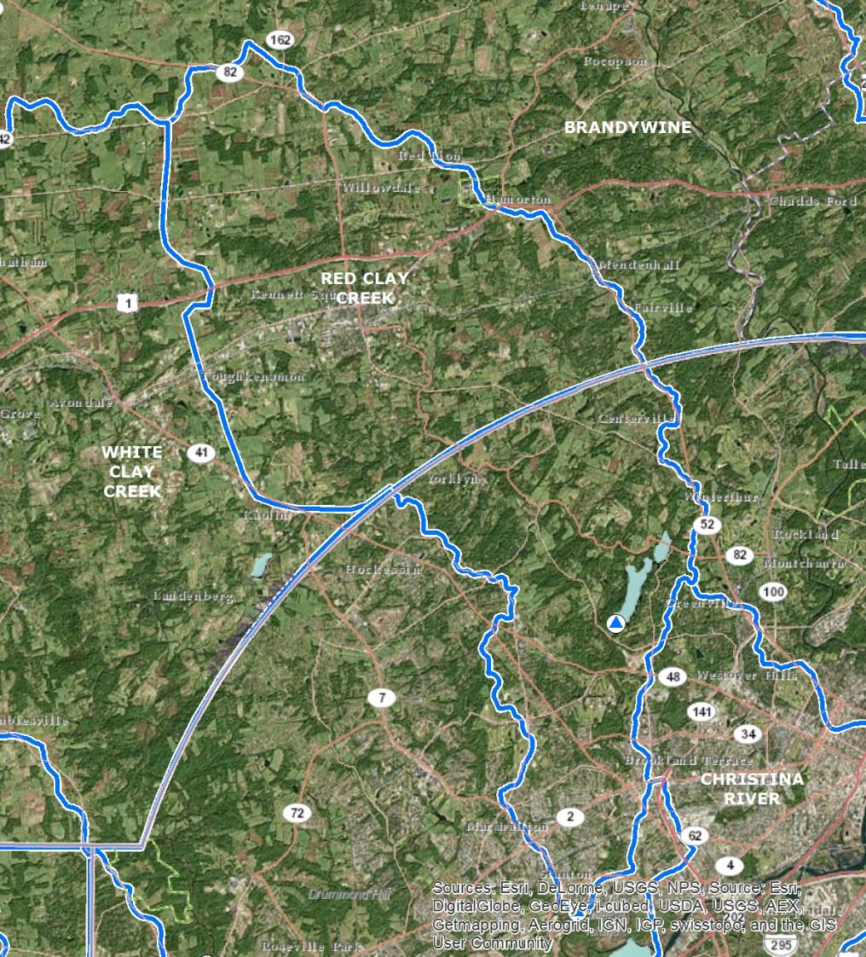
4 Modeling
The Red Clay
Creek
Watershed

Slide 28
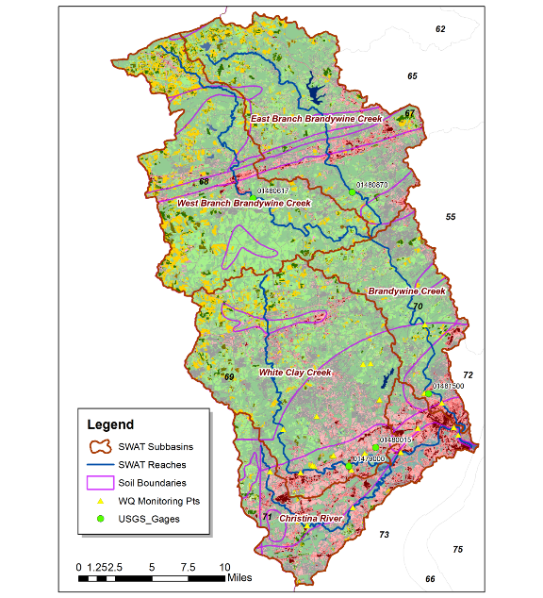
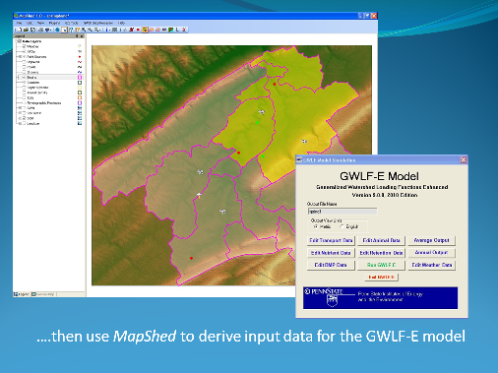
MapShed PRELIMINARY analysis
SWAT
Center for Naval Analyses

Slide 29
Estimated Annual Agricultural Loads by Land Cover Type
Sediment | Hay/Past | Cropland | Turfgrass
R01 | 241.96 | 1113.45 | 35.6
R02 | 124.96 | 522.49 | 62.6
R03 | 117.74 | 1003.57 | 60.39
R04 | 101.24 | 421.05 | 21.12
R05 | 79.07 | 152.54 | 42.34
R06 | 125.95 | 769.46 | 36.21
R07 | 12.82 | 39.79 | 6.48
R08 | 9.23 | 10.74 | 31.33
R09 | 0.49 | 0.43 | 3.03
TN | Hay/Past | Cropland | Turfgrass
R01 | 647.22 | 2900.79 | 196.96
R02 | 330.86 | 1244.31 | 263.78
R03 | 324.31 | 2537.08 | 299.35
R04 | 239.19 | 973.29 | 90.62
R05 | 189.53 | 366.65 | 166.1
R06 | 313.49 | 1823.42 | 191.28
R07 | 36.15 | 99.27 | 30.92
R08 | 25.29 | 26.75 | 179.35
R09 | 4.34 | 4.1 | 29.48
TP | Hay/Past | Cropland | Turfgrass
R01 | 235.46 | 907.4 | 40.19
R02 | 112.04 | 384.74 | 57.43
R03 | 109.88 | 753 | 59.95
R04 | 74.21 | 274.5 | 17.4
R05 | 58.58 | 100.37 | 33.55
R06 | 105.44 | 553.77 | 36.12
R07 | 10.45 | 25.14 | 5.32
R08 | 7.33 | 6.77 | 28.07
R09 | 1.1 | 0.45 | 3.42
MapShed PRELIMINARY estimates

Slide 30
Sources
MapShed PRELIMINARY estimates

Slide 31
Yields by Land Cover
Sources
MapShed PRELIMINARY estimates

Slide 32
Loads
Allocation
PSU (Evans)
2010 LU data
USGS, 2002
2006 TMDL
USGS/HSPF
1994-1998
@Stanton,
2009-2011
* PRELIMINARY

Slide 33
Loads
Allocation
PSU (Evans)
2010 LU data
USGS, 2002
2006 TMDL
USGS/HSPF
1994-1998
@Stanton,
2009-2011
* PRELIMINARY

Slide 34
Loads
Allocation
PSU (Evans)
2010 LU data
USGS, 2002
2006 TMDL
USGS/HSPF
1994-1998
@Kennett Square,
2009-2011
* PRELIMINARY

Slide 35
Example ag-source loads and potential reductions, by subshed
Reductions

Slide 36
“Buildout” Ag BMP Costs in the Red Clay
BMP | TotalAg | AgUnits | Existing | Potential | BMPCost | CostUnits | TotPotAnnualCost
Cover Crops | 1,187 | acres | 0 | 1,187 | 40 | $/ac/year | 47,469
Conservation Tillage | 1,187 | acres | 0 | 1,187 | 0 | $/ac/year | -
Contour Farming | 1,187 | acres | 0 | 1,187 | 10 | $/ac/year | 11,867
Conservation Plan | 9,302 | acres | 0 | 9,302 | 2.18 | $/ac/year | 20,278
Nutrient Management | 9,302 | acres | 0 | 9,302 | 9.1 | $/ac/year | 84,645
Riparian Buffers | 374 | acres | 0 | 280 | 195.93 | $/ac/year | 54,903
Fencing | 374 | Acres | 0 | 93 | 5840.3 | $/ac/year | 545,517
 |  |  |  |  |  |  | 764,679
Costs

Slide 37
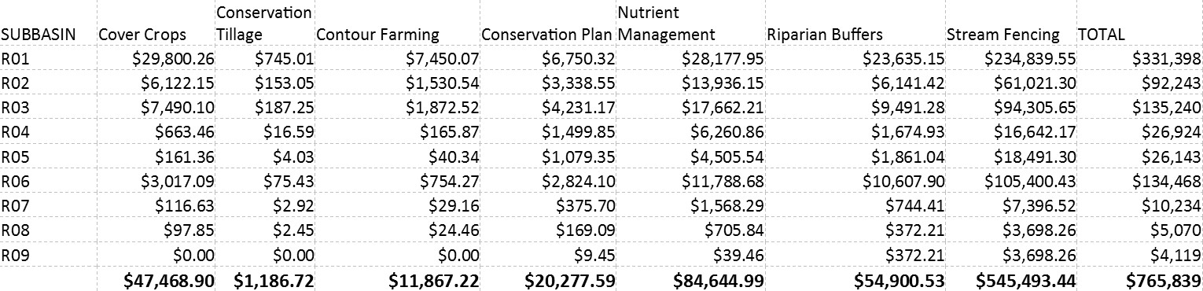
Estimated Annual Agricultural BMP Costs by subbasin
Costs

Slide 38
Costs

Slide 39
West Branch Brandywine
Restoration Plan
(Clauser Assoc.)
Sediment | Hay/Past | Cropland | Turfgrass
R01 | 241.96 | 1113.45 | 35.6
R02 | 124.96 | 522.49 | 62.6
R03 | 117.74 | 1003.57 | 60.39
R04 | 101.24 | 421.05 | 21.12
R05 | 79.07 | 152.54 | 42.34
R06 | 125.95 | 769.46 | 36.21
R07 | 12.82 | 39.79 | 6.48
R08 | 9.23 | 10.74 | 31.33
R09 | 0.49 | 0.43 | 3.03

Slide 40
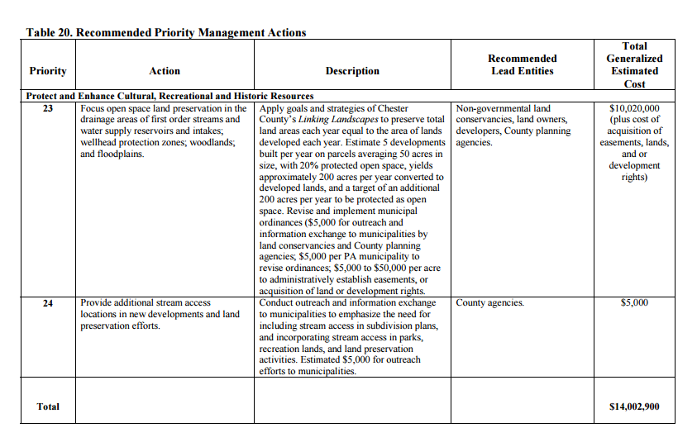
Red Clay Creek
Watershed Action Plan
(CCWRA et al.)
5 year implementation,
$800,000/year,
non-preservation

Slide 41
Understanding return on investment
Resource Investment Optimization System (RIOS) and Integrated Valuation of Ecosystem Services and Tradeoffs (InVEST) models

Slide 42
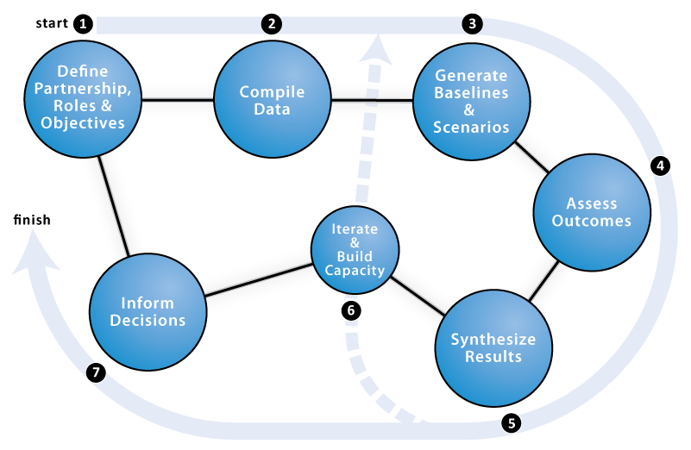


Planning Context
Notes:
RIOS prioritizes areas for PWS based on relative scoring of potential ES impacts, which can help target payments across landscapes. InVEST can quantify ES in biophysical terms (e.g. cubic meters of water), which can help to identify service providers and beneficiaries. It can also estimate economic values, in dollar terms, using a range of techniques e.g. avoided damage or treatment costs and market valuation. Valuation can only be completed once the biophysical parts of the models are calibrated to time series data. Given the simplifications in the biophysical and economic models, economic values should be treated as first estimates only, e.g. for gaining support for PWS.

Slide 43
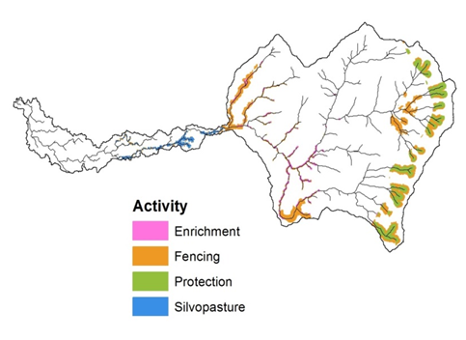
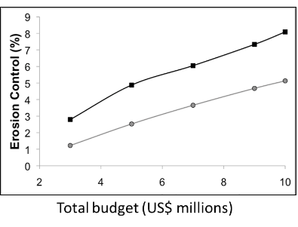
Resource Investment Optimization System (RIOS)
GOALS
Guide investment in watershed services within budget
Maximize investment for improvement in multiple services
QUESTIONS
Which activities are most cost-effective?
Where should I do them?

Slide 44
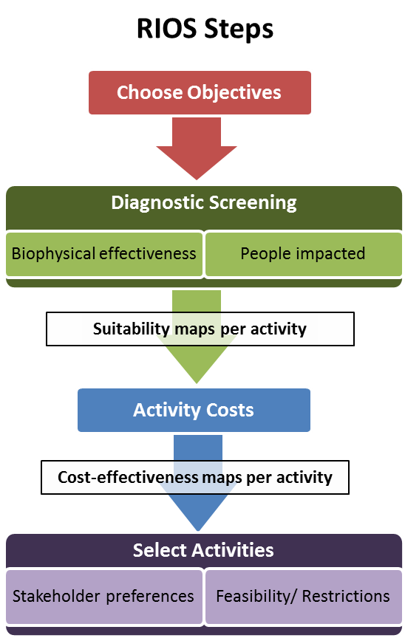
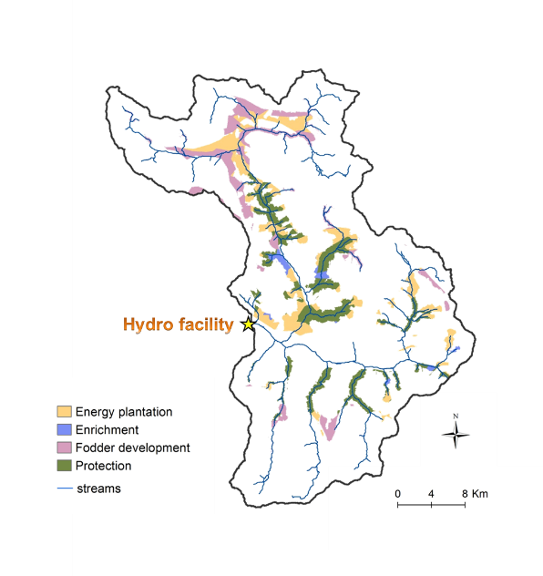
Resource Investment Optimization System (RIOS)
WHAT activities to invest in and WHERE

Slide 45

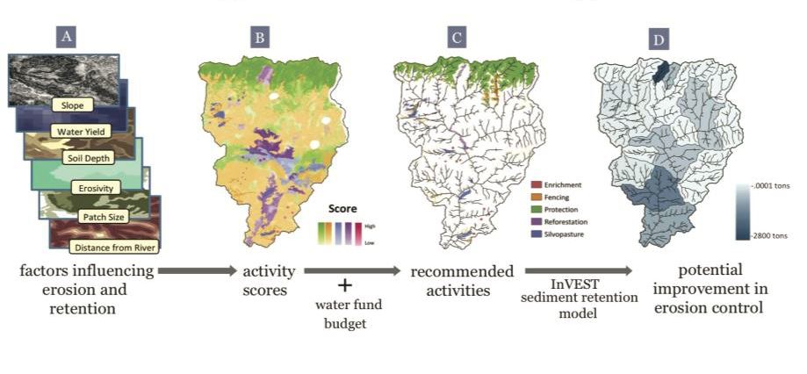
Integrated Valuation of Ecosystem Services and Tradeoffs (InVEST)
GOALS
Map and value the goods and services from nature
Assess quantified tradeoffs associated with alternative management choices
Example
Cauca Valley, Colombia

Slide 46
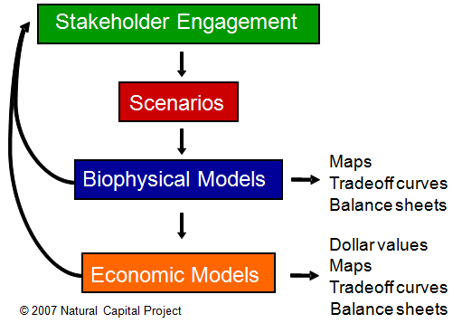
Integrated Valuation of Ecosystem Services and Tradeoffs (InVEST)
RESULTS
Biophysical terms (e.g., tons of carbon sequestered)
Economic terms (e.g., net present value of that sequestered carbon)

